Slide 1
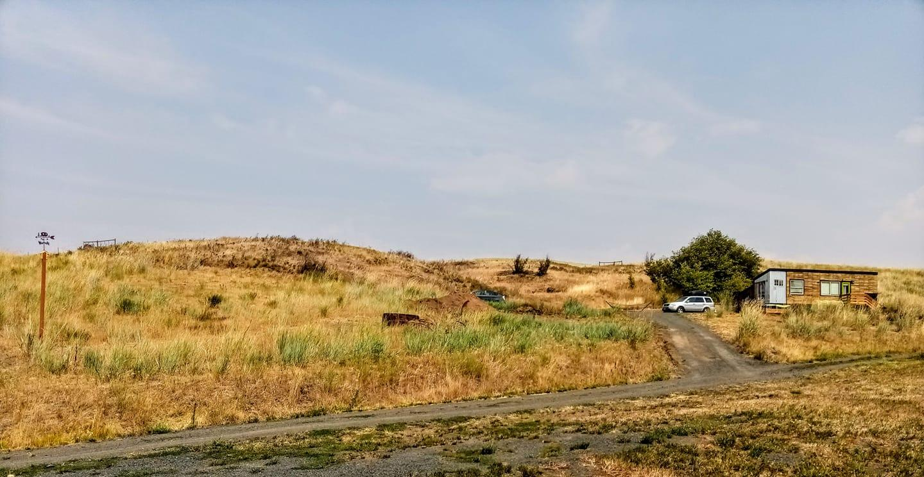
Movable Tiny Home
Macy Miller - mizacy@gmail.com
Moscow, ID
Self Built, Legally Placed

Slide 2
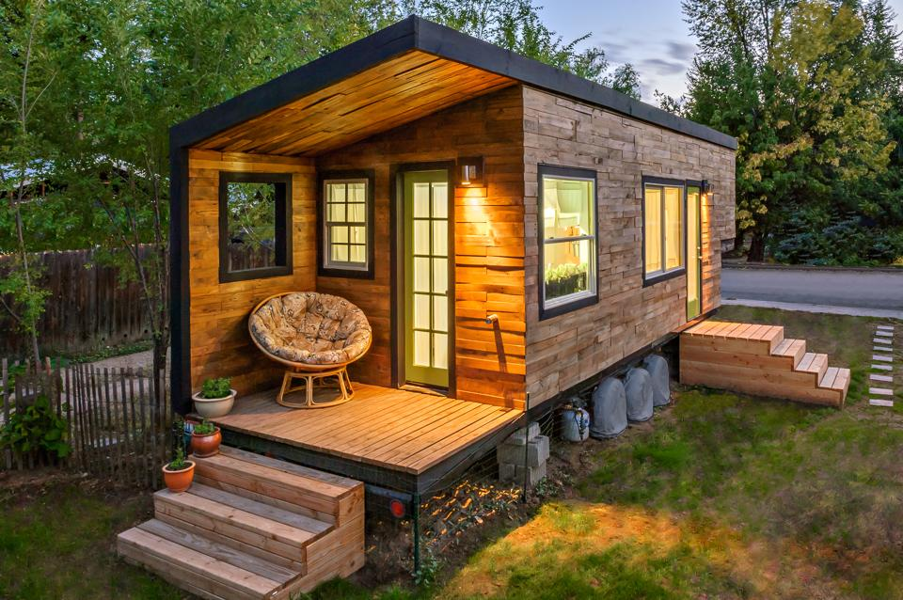
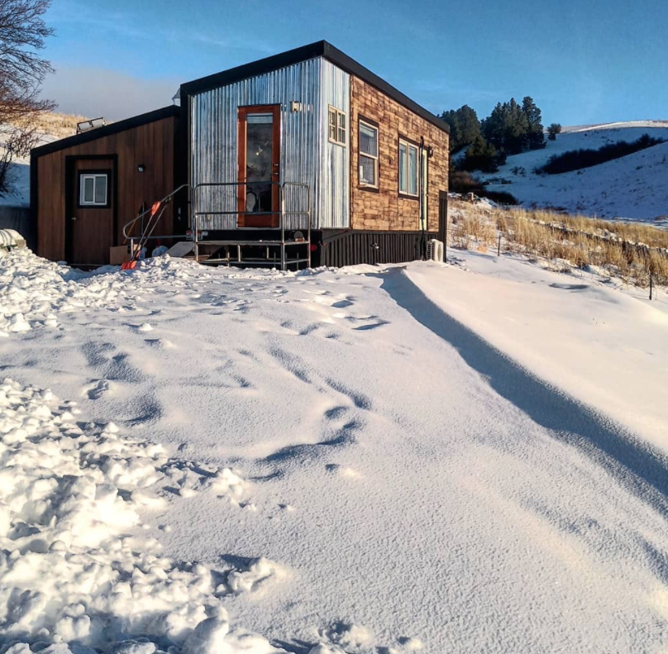
Movable Tiny House
My Tiny House
A new housing type
DOT & IRC Standards
< 400 s.f.
232 s.f.
$11,416
18 months construction time
IRC Code Compliant
‘Home’ for 10 years

Slide 3
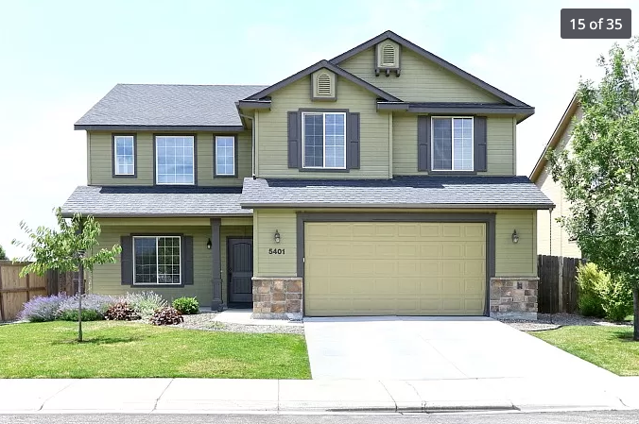
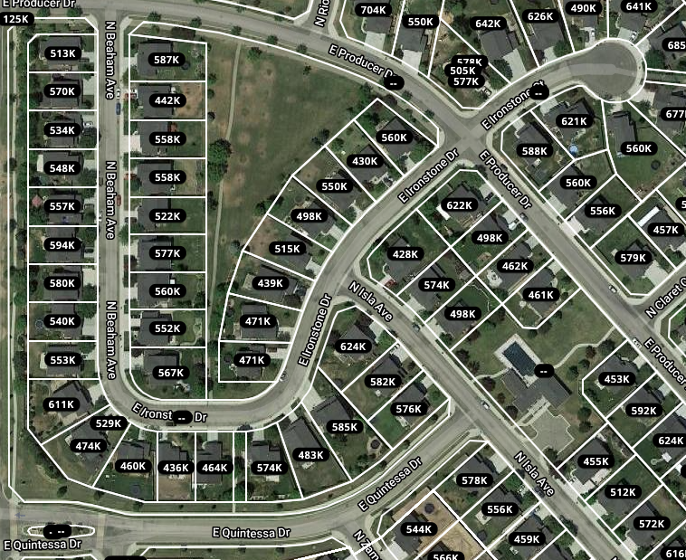
Why I did it
Other Reasons
I was OVER financed and under qualified
I was unhappy and trapped
I not sure about a 30 year plan
Generational living
Pursue passion careers
Traveling professional
Avoid Excess
Live near work

Slide 4


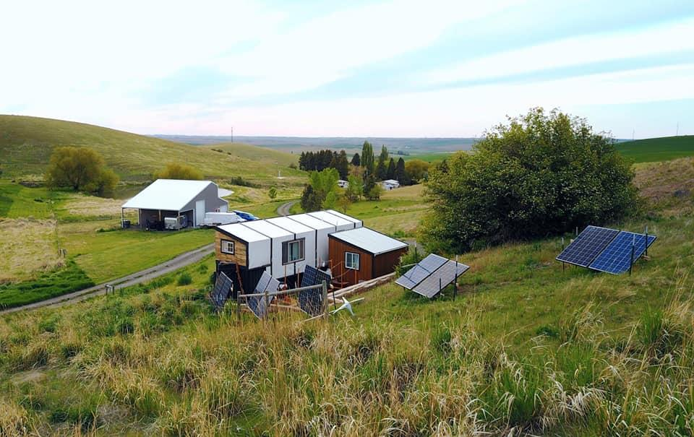
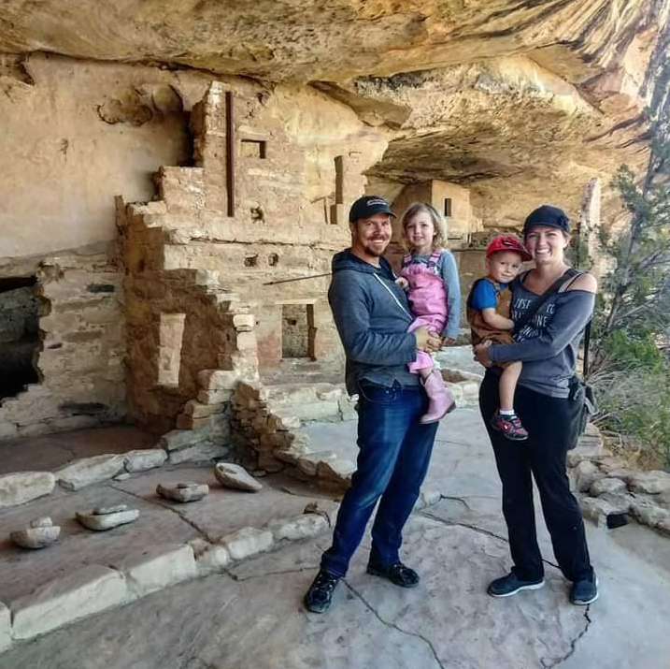

Why I Keep Doing It
It works!
It is not an act of desperation

Slide 5
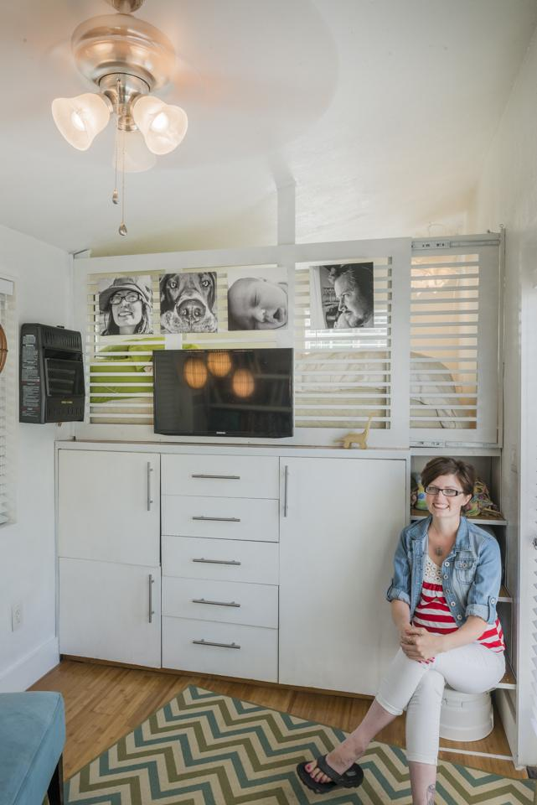
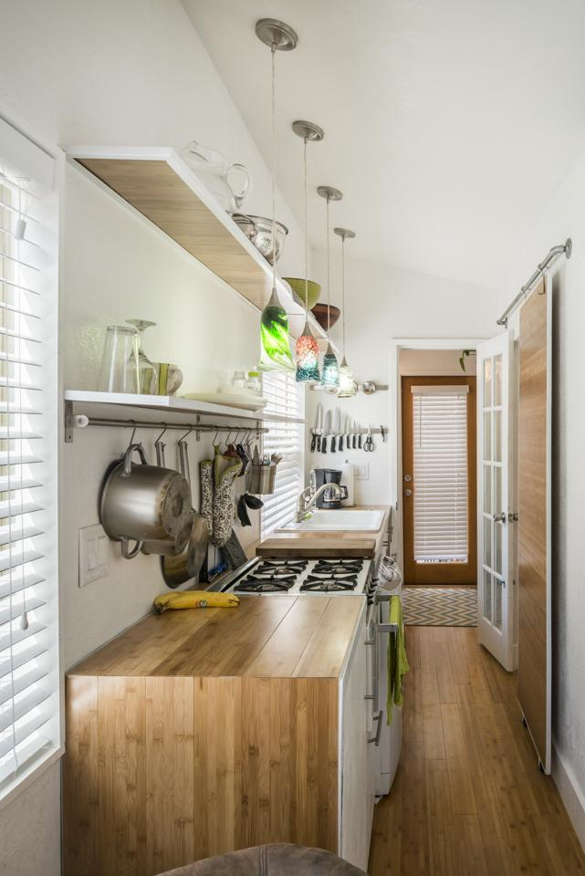
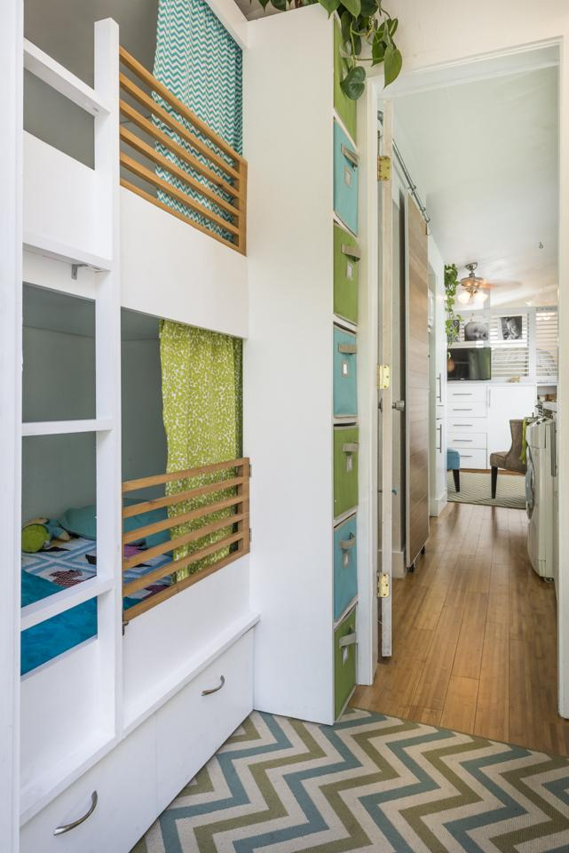
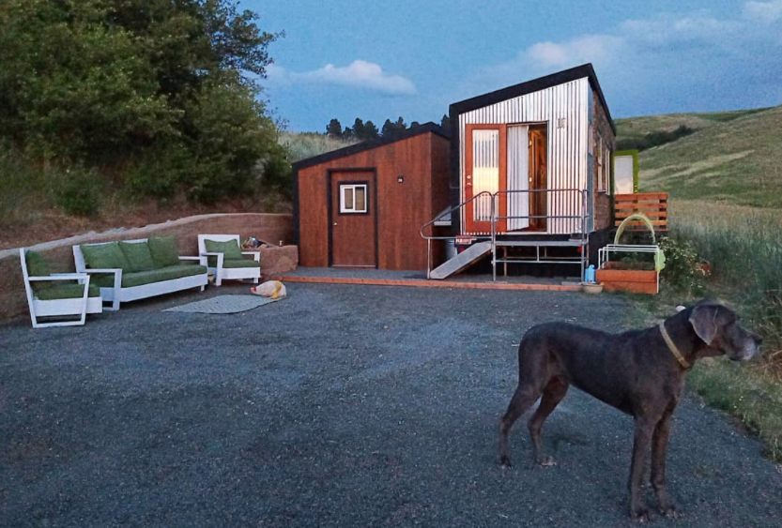
How the project is sustained
Owner occupied and maintained
Start at $30,000-$100,000
Owner or builder financed
We’re told they will depreciate
Land host partnerships

Slide 6
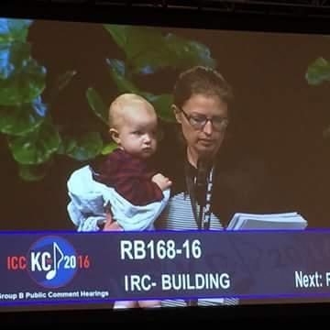
Partners and their roles
Mass Media Momentum
Crowdsourced Code Changes
Local Zoning
Non-profit participation
School Involvement

Slide 7
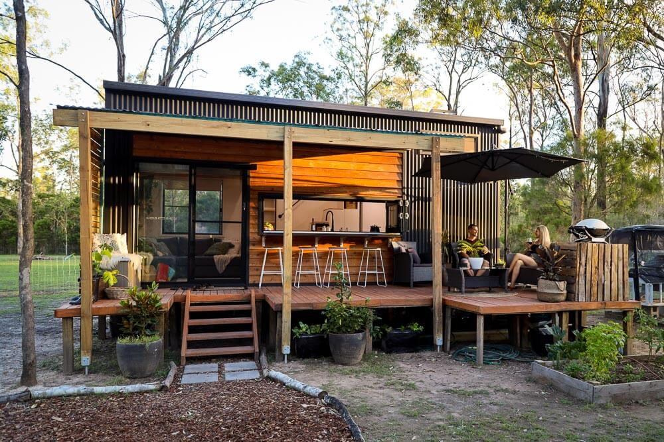
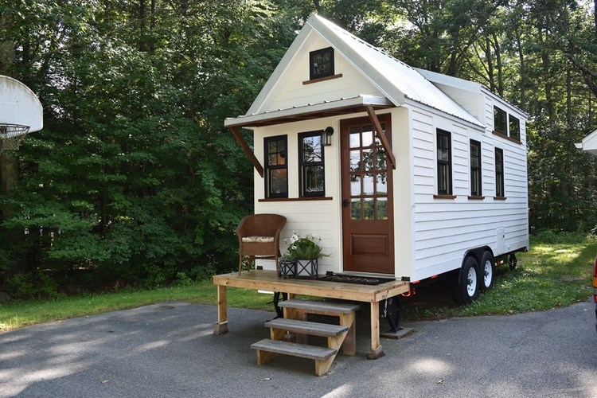
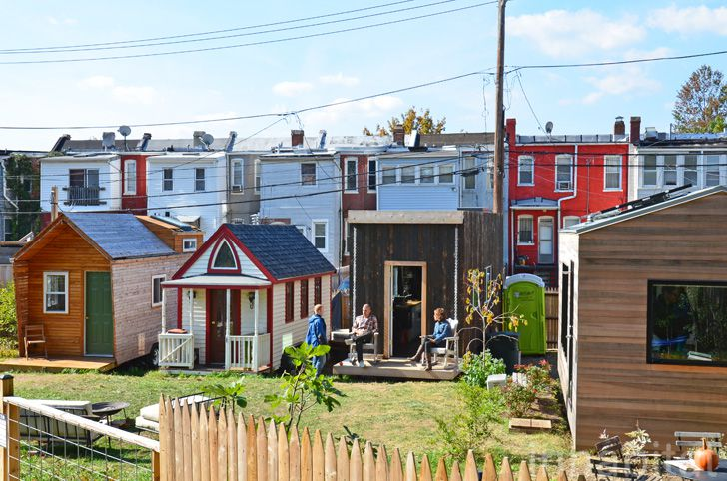
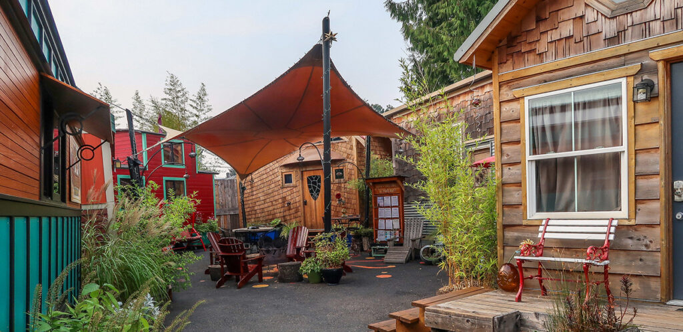
Overall community benefit
Owner Occupied Affordable Housing
Housing where jobs are
People spend more in their community
Community infill on substandard lots
Offset House-poor individuals
Increase density within existing infrastructure

Slide 8
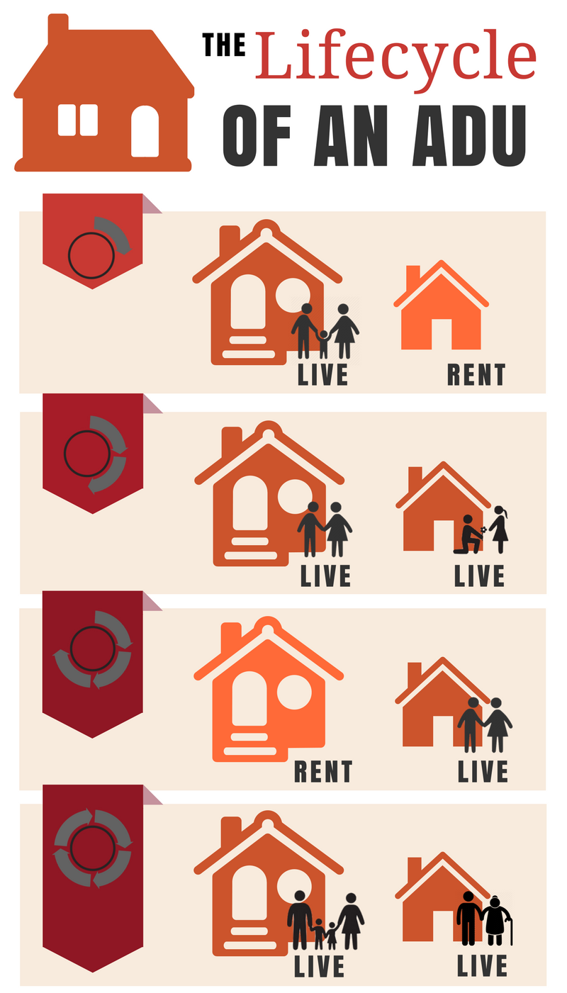
Methods of legalization
Concerns
Strength is in owner occupancy
ANSI Code (Emergency Housing Method)
IRC Code (Appendix Q)
RV Zoning (Local regulation)
Movable Tiny House ADU Pad
Tax models
Inspections for code compliance
Zoning

