Slide 1
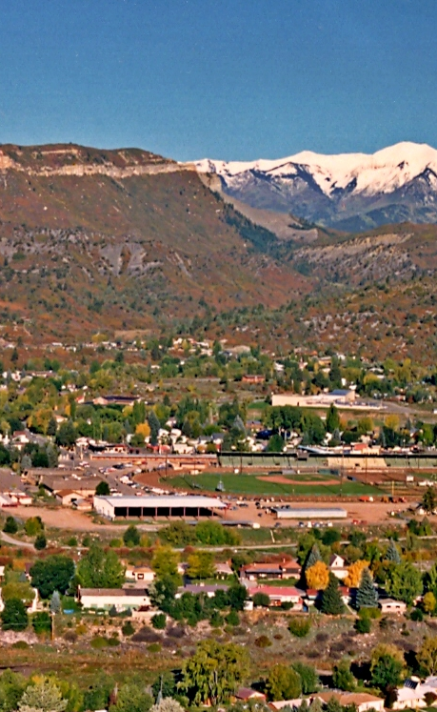
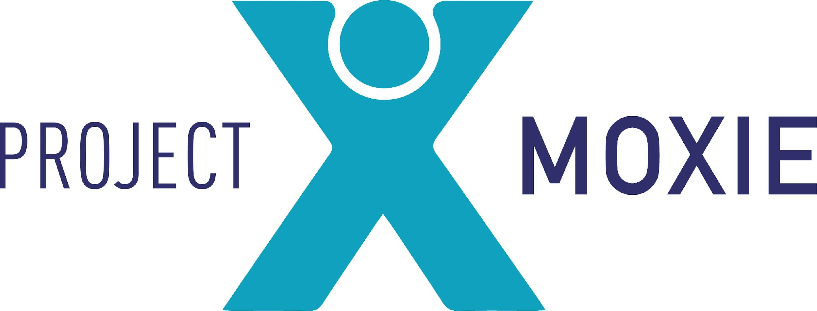
Community Housing Strategy 101
Notes:
welcome from Mike French and Jonathan

Slide 2

Jennifer Lopez Founder, Project Moxie
Fort Lewis College Class of 1995-Go Skyhawks!
22 years of experience in affordable housing.
Held a senior position in the Hickenlooper administration in Colorado and led regional housing efforts in southwest Colorado for several years.
Masterful resource developer……I love asking for dollars and helping you to design your program and tell your story.
Worked at local and state government, private sector and nonprofit sector.
Current clients include: The Colorado Health Foundation, Anchorum St. Vincent, Mercy Housing, Fort Morgan Community United for Progress, New Mexico Coalition to End Homelessness, Pitkin County, Total Concept and MGL Partners.
Encouraging, strategic and professional–walking with you to define and create housing for your community.
I love this work. If we aren’t enjoying the process, we will never get there. We must make space to play, to laugh and let off steam.
Karaoke anyone?

Slide 3




Project Moxie
Good at doing good.
1 Community Driven
Communities know what will work and should drive the process
Those we want to serve are involved in decision-making and design
Each community is unique and their solutions for housing and shelter are as well
Relationships are key, and each project results in a more robust, connected community
2 Results-Driven
Projects in three states; collectively the team has developed thousands of housing opportunities
Longevity; the principals have been in business for more than 20 years
Diverse client and geographic base
We find the right people and resources to get the project done
3 Government Experience
Knowledge of how government works and what it needs to get to yes on each project
Creating public value and support
Taking the time to engage the public
Respect for multiple stakeholders and finding ways to meet the community’s needs
4 Creative Resource Development
• Developing unique partnerships
- attracting investors and funders through powerful storytelling and clear project visions
- Leveraging existing resources in new ways
Partnering throughout the process
Unique volunteer models to strengthen community once these projects “go live”
-

Slide 4





Project Moxie Team
Cynthia Roebuck, land use consultant
Jenn Lopez, President
Matt Lynn, Director of Engagement
Dr. Kathleen VanVoorhis, Director of Strategy
Gary Sanford, homeless programs consultant
Hollis Walker, project manager

Slide 5
Sample Projects
Supportive Housing developments
tax credit developments
Employer housing initiatives
Housing in partnership with congregations
Community based strategy development
Motel Conversions
Safe Outdoor Spaces
Communications strategies for policy work
technical assistance for local governments
capacity building and new organizational development

Slide 6
Housing consulting that starts and ends with community
Listening and launching projects with community
Positioning project control through access to resources: site control, funding or organizing
technical assistance to navigate housing funding
Selecting mission-driven partners
Innovation–what can happen to meet this communities’ needs specifically?
Notes:
Fort Morgan Example
Earthlinks

Slide 7
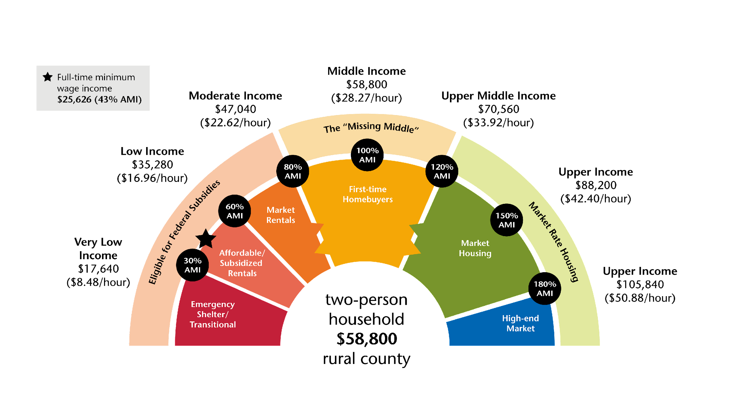
Healthy Housing Continuums
Housing Bridge
Source: Cappelli Consulting, Williford, LLC and CHFA

Slide 8
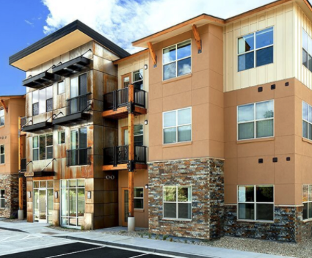
Presentation
Creating the Context: The Housing Market
Terminology
Housing Toolbox–examples from SW Colorado
Strategy development
Q&A/Discussion

Slide 9
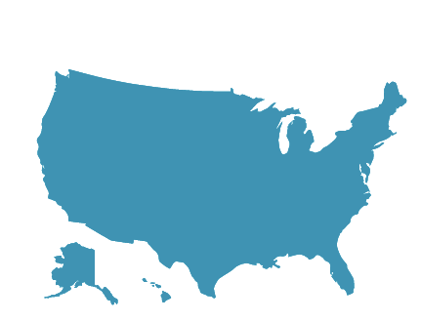
The National Housing Market in 2022
Economic outlook: Incomes are projected to increase by 3.3% and with many employers looking to attract and retain talent without impacting costs, we expect workplace flexibility will continue.
Financial sector adjustments: The Federal Reserve is expected to raise interest rates a few times in 2022, which means mortgage rates will likely rise. Both Redfin and Realtor.com predict the 30-year-fixed mortgage rate will reach 3.60%.This means that despite high housing demand and insufficient housing supply, investors will be disincentivized from acting in the space (less money to be made from investing in housing, reduce churn).
Housing market response: Zillow predicts home values will rise by 11% in 2022 — not as much growth as in 2021, but still substantial.
Takeaway: Housing affordability will remain a key issue as the nation’s rental housing market tries to stabilize from lingering pandemic and housing stock issues. Supply chain delays and continued inflation will also impact every facet of the industry, from property managers to renters to owners.

Slide 10
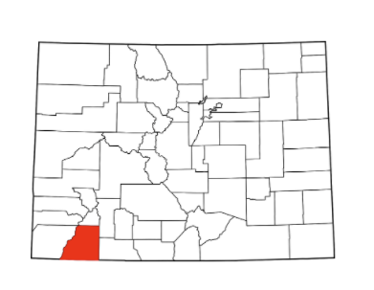
Example of a Local Housing Market LPC
Housing Supply Challenges
Diminishing Supply: In November 2021, 48% fewer residential units were available for sale compared to November 2020.
Lightning Absorption: Durango has a total of six available single-family homes with 19 pending sales. In the Durango area, there are currently 62 properties for sale… with 62 pending sales.
Resort Pressure: “...even tighter inventory levels, with just three active properties, all priced over $1 million. Condo/townhome inventory fell by >72% compared to 2021. This lack of available units reduced sale rates. Average sale price was just under $550,000.”
Economic Impacts
Employers are struggling to fill positions in virtually every sector. The Durango Herald ran an article this week stating that the city is operating at just 50% capacity for its snowplow drivers. The school district is holding job fairs to fill admin and substitute teacher positions. The City of Durango has more than 50 unfilled positions.
Housing Cost Challenges
The average sales price for November exceeded $1 million for the first time ever. The median home price for November was $740,000, also an all-time high, up 25% from 2020.
Takeaway: We need bold, new, courageous strategies to address the significant need in our community, and we need to start building now.
Source: Dec 2021 Colorado Association of Realtors Data

Slide 11
For Consideration
What is happening in your housing market?
What does “housing affordability” mean to you? Affordable to whom?
What would an equitable housing market in your community look like?

Slide 12
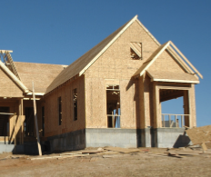
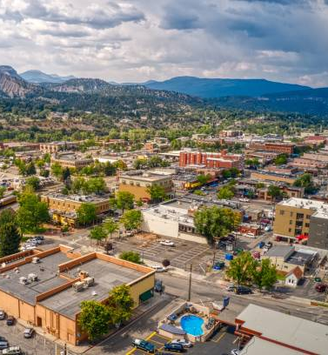

What’s causing demand issues?
In short, we have not kept up with market demand for years.
Present day contributing factors include:
COVID impacts — we had an increase in demand as people “fled” urban areas to work remotely from here. We have less than 2 weeks of inventory. A balanced market is 6 months of inventory.
Supply chain issues — we can’t get the materials to build, or the prices are inflated.
Land inventory — we don’t have enough land with infrastructure at scale ready to go.
Labor issues — we don’t have enough labor to build.
Market mismatch — The market builds to the market: if the demand is for high-end homes, that is what we get.
Wages — wage growth has significantly lagged behind rent and home price increases year over year.

Slide 13
What is “affordable housing”?
Affordable housing means paying no more than 30% of gross income for rent/mortgage + utilities
Regulated affordable housing — what we commonly refer to as “affordable housing” are homes that have income restrictions. When the public sector invests in a housing unit, a restrictive covenant or land use restriction agreement is recorded. These limit the cost of the unit and who is eligible to rent or buy the home.
Naturally occurring affordable housing (NOAH) — this is market-rate housing that happens to be leased or sold affordably.

Slide 14

What is traditionally considered“affordable housing?”
$61,400
(one person)
Area Median Income (AMI) =
x 30%
$18,420
$21,060
$23,700
$26,310
A single parent working 40 hours/week at minimum wage
x 50%
$30,700
$35,100
$39,500
$43,850
x 60%
$36,840
$42,120
$47,400
$52,620
x 80%
Two parents each working full time at minimum wage
$49,120
$56,160
$63,200
$70,160
x 100%
$61,400
$70,200
$79,00
$87,700

Slide 15
More terms and definitions
Below-Market Housing
Housing at affordability levels that the market currently does not provide on its own.
We prefer this term because it eliminates the ambiguity or preconceived notions sometimes elicited by the categories to the left.
Example: many very low income households work, some moderate income households don’t work, and none of the categories to the right explicitly name seniors adults.
Share your thoughts on the definition of each term…
“Workforce Housing”
2. “Middle Income Housing”
Used often at the local level to define the need of the low-moderate income workforce. This includes those in the service, recreation, and often civil service sectors.
Used to indicate affordability for white collar households.
3. “Community Housing”
4. “Attainable Housing”
Used to indicate affordability for low to moderate income households with an emphasis on local residents.
Used interchangeably with the categories to the left and above depending on context. Usually not used to refer to very low income housing.

Slide 16
Strategies & Tools
Development Subsidy
Household Subsidy
Below market housing tends to be developed through one of two of the following strategies:
Note: these strategies can be (and often are) combined.
Reduce the costs of developing new below-market housing so people earning a certain income level can afford it.
Put another way, it allows the developer to be able to afford to offer below market rent or mortgage without going bankrupt.
In essence, it brings housing costs down to match local incomes.
Reduce a person’s housing costs through rent assistance (such as Section 8 Vouchers) or mortgage assistance.
In either case, a payment is provided to the household to cover the difference between what they can afford (<30% of income) and what their housing costs.
In essence, it adds to household incomes to match housing costs
Notes:
LISA - Subsidize housing development costs, by discounting land, offsetting infrastructure, receiving equity through tax credits, receiving gap funding through the state or local government and finding ways to engineer costs savings during construction. [add above]

Slide 17
Example of Funding Gaps Implicit in Below Market Housing Construction
Sample Development A (based on a real world example)
Multifamily; 45 units ; 2 bedrooms ; 1000 sqft
What it cost to build
Who its trying to serve
30% AMI
60% AMI
$8.8M
Total Development Cost
Monthly Rent | $375 | $852
Total Annual Rent (Income) | $202,000 | $460,000
Less Operating Costs | ($150,000) | ($150,000)
Net Operating Income (NOI) | $52,000 | $310,000
Mortgage Size | $250,000 | $1.2M
Capital Gap (Equity Needs) | $8.5M | $7.6M
$200K
Soft Cost: Design, Permit, Fees
$300K
Infrastructure Cost
$300K
Land Cost
$8M
Construction Cost
Data Source: Cappelli Consulting, Williford, Inc. and Housing Colorado, “Living Affordably Colorado”

Slide 18



Example of Market-Rate Housing Construction Costs By Comparison
Sample Development B (based on a real world example)
Single Family ; 1600 sqft ; Market Rate
What it costs to build
Who we are trying to serve
Community Investment
$457K
Total Development Cost
$25K
Profit
$14K
Soft Cost: Design, Permit, Fees
$42K
Infrastructure Cost
$65K
Land Cost
$482K
Purchase Price (140% AMI)
$336K
Construction Cost
No Investment/Subsidy Required
Data Source: Cappelli Consulting, Williford, Inc. and Housing Colorado, “Living Affordably Colorado”

Slide 19
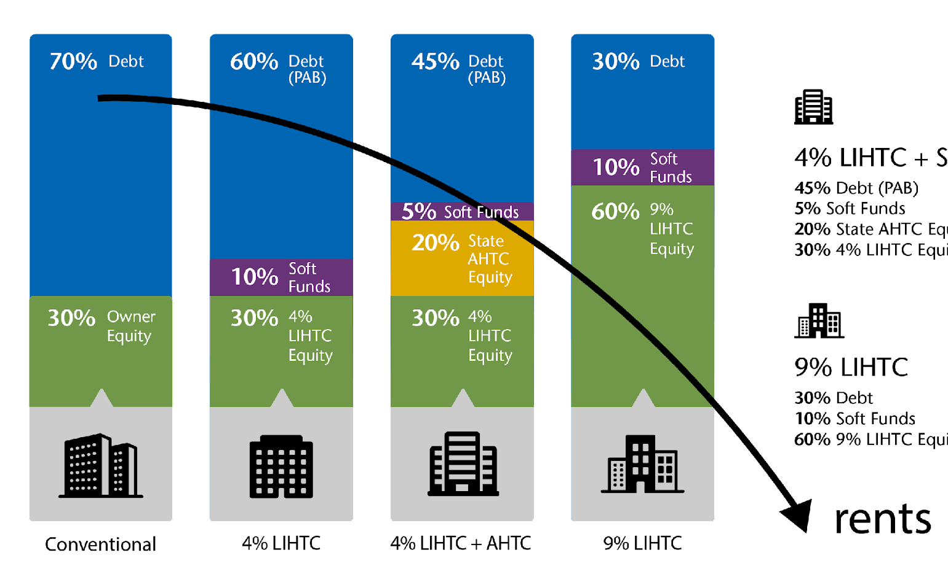
Multifamily Market Rate & Below Market Development Cost Side-By-Side
These charts show the percent of the total project cost a bank is willing to lend based on its affordability
Market Rate Apartment
Low-Mod Income
Low-Income
Very Low Income
The less in traditional financing received …
The higher rents are, the more $$ traditional lenders are willing to lend
The greater the need for subsidy/alternative financing
...and the more likely they have cash to cover any gaps
The lower rent… the less money traditional lenders are willing to lend…
…But the greater the public/philanthropic subsidy potential
2021 Estimates

Slide 20
Strategy Development
Housing strategy emerges where a community’s vision, resources, and capacity meets political will, creativity and partnership.
Vision, resources, capacity
Political will, creativity, partnership
Strategy

Slide 21




Housing Toolbox
Incentives | Partnerships/ Public Initiatives | Development Regulations | Funding
Density bonuses | Providing County or Town land | Inclusionary Housing | Grants: Federal, State, Foundation
Fee waivers | Town or County builds housing | Residential linkage | Proceeds from regulations
Reduced parking | Public provide financing | Commercial linkage | Low Income Housing Tax Credits
Fast track processing | Property tax exemption | Annexation policy | General fund revenues
Reduce min lot/ house size | Habitat for Humanity/ Self help |  | Favorable loans
Allow affordable housing all/most zones |  |  | Tax: Property, Sales/Use, Excise on STR, Marijuana, GO Bond

Slide 22

Community Roles– Strategy Relies on Clarity
For-profit and nonprofit developers—undertake development activities and increase net new housing units. To educate and inform the community of barriers to the market for building more affordable and moderate-income housing.
Advocates- educate the community about needs and solutions. They seek to increase housing opportunities for the community.
Service providers-to help stabilize households…we see more services are needed to help people maintain their housing. Most housing needs services onsite for tenant stabilization.
Funders—they can fund collaboration, capacity building and direct projects. They often are asked to help convene and develop ideas and solutions. They can provide resources and best practices through consultants and funder networks. They support and help to catalyze.

Slide 23
Community Roles –sitting in the right seat
Local Governments- Create capacity to manage strategy is critical. They create land use and other policies that make it easier to develop affordable housing. They donate land, waive fees, and assist with resources, when possible.
Sponsors- this is the entity that actively takes on a project by driving it through resource provision and project management support.
Anchor Institutions—churches, hospitals, school districts, colleges etc. are playing a bigger role in creating solutions. Think land or other resources.
Community members/ Residents- they understand what works from site location to building amenities.

Slide 24
Housing Strategy 101
Preserve Existing Housing
Promote & Develop New Housing
Increase Access to Housing Opportunity
Preserve existing affordable units through:
Home or renter rehab,
Mobile home park preservation
Preservation of NOAH (Naturally Occurring Affordable Housing)
Promote and develop new rental housing
Promote and develop new for-sale housing
Stabilize and create access to all types of housing through services
Homebuyer education/renter education/tenant rights workshops/homeless prevention
Notes:
JENN

Slide 25
Preserve existing below market housing
River View (mobile home preservation w/ROC USA):
Residents of the 120-unit Riverview Mobile Home Park formed the Animas View MHP Co-op in early 2021 to organize and secure funding to purchase their mobile home park that went up for sale in late 2020 (14 million and multiple funders)
Tamarin square preservation 2020/21:
How it was done: local allocation of Private Activity Bonds, and tax credits and additional development capacity with willing property owner. Rehabbed and extended the affordability period for an additional 20 years.
What’s Next: Expect requests from Mercy Housing to preserve properties in 2023 and 2024-over 100 units built over 15 years ago.
Notes:
JENN

Slide 26
Promote and develop below market housing
Identify a development pipeline and help to subsidize land development (capacity plus resources) so that we can create below-market opportunities.
Increase development capacity through public/private partnerships for vertical development.
Subsidize development with increased state and federal funding resources as well as use public financing tools to offset development costs.
Simplify and streamline the planning and entitlement process.
Create a supportive development environment and create consistency across the region.
Notes:
JENN

Slide 27
Stabilize those who are housed already
Service Providers manage several programs that help navigate housing opportunities for local residents
This also includes programs to prevent homelessness and to rapidly rehouse those that fall into homelessness.
Programs that provide emergency assistance, financial literacy classes and help navigate benefits are critical to stabilizing those that are already housed.
In the last two years we have seen a significant need and increase in tenant protections counseling, education and eviction prevention programs.
Notes:
JENN

Slide 28
Capacity Building
Support core program infrastructure-what is working now?
If you need additional program capacity can you recruit an agency in or do you build from scratch?
Assist local governments with grants, program management and policy development.
Support private developers interested and willing to create new below-market housing opportunities.
Continue to import development partners with expertise in tax credits and below market financing through government loan programs.
What is the role of policy? Limit short-term rentals, Inclusionary zoning, second home taxes etc?
Notes:
JENN

Slide 29
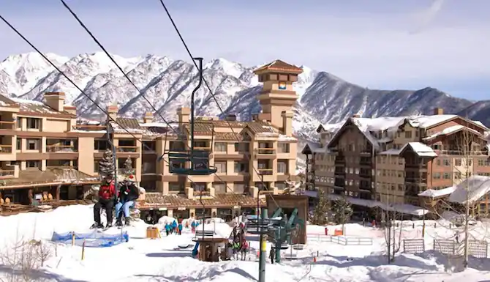
Private Sector Strategies
Work with employers to identify resources including potential redevelopment sites.
Continue building mortgage assistance programs-employer funded that can be matched with public resources.
What is the current development pipeline and is there an immediate opportunity to work with private developers to decrease costs to deliver some below market housing?
Educate private sector on opportunities with new federal and state funds.
Notes:
JENN

Slide 30
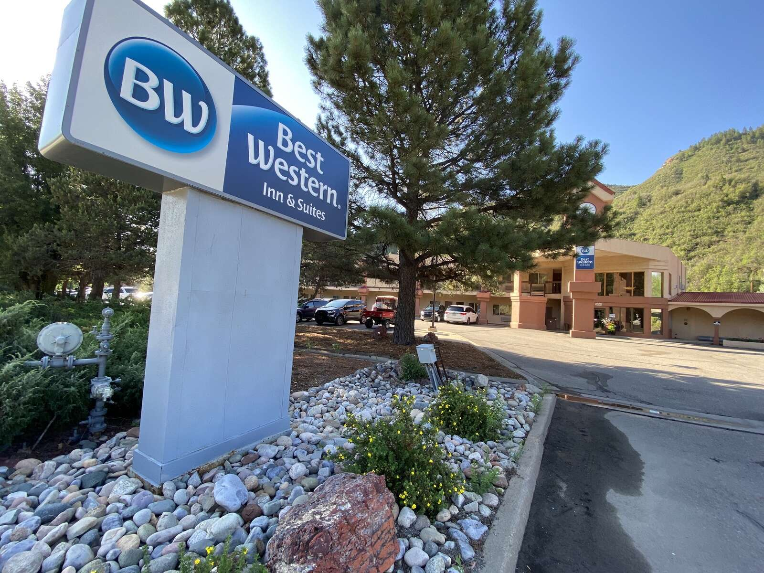
Public Sector Strategies
Repurpose underutilized assets.
Identify redevelopment opportunities
Create public will for increased residential development.
Identify incentives like predevelopment funding to activate public sites.
Fund and support existing programs and other nonprofit partners to scale efforts when possible and build local capacity for the long-term.
Identify/create a local public funding stream for housing.
Photo credit: The Durango Herald
Notes:
JENN

Slide 31
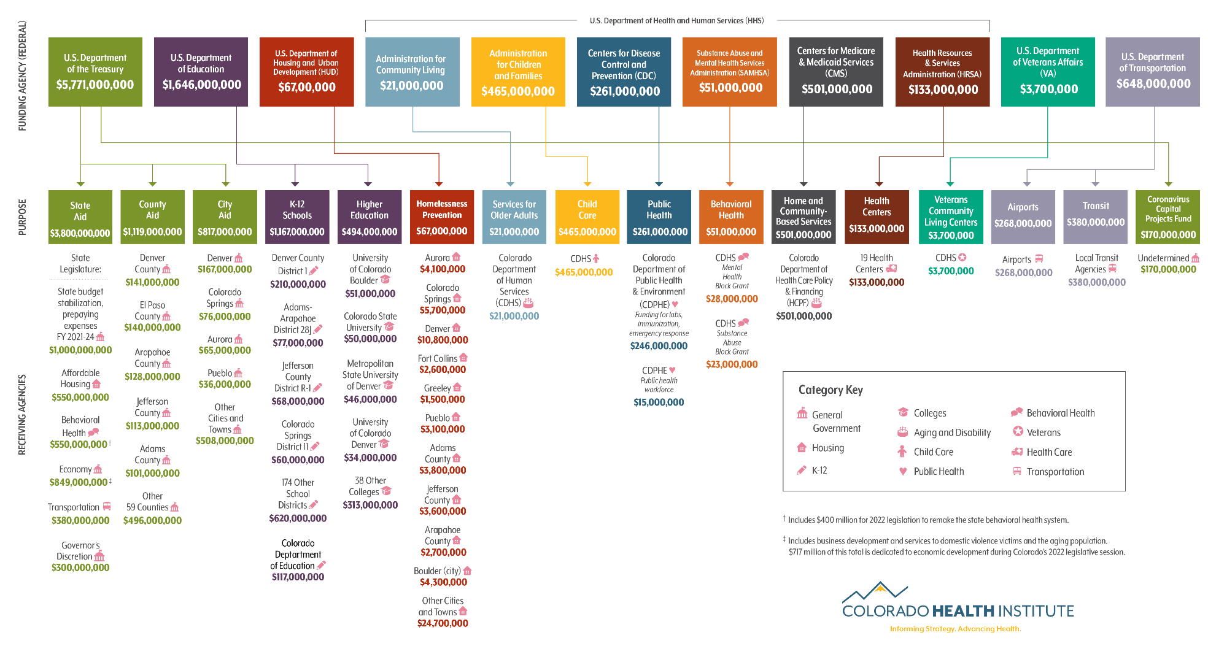
Current Context - ARPA
Notes:
Jonathan

Slide 32
Action Steps
Communities need to do some broad community strategy work AND support an actual project at the same time.
Strategy work aligns resources with capacity for several efforts–it is an investment of time and energy.
Having an actual project garners momentum, creates hope and excitement and moves the community towards housing as soon as possible.
Notes:
JENN

Slide 33
La Plata County Example
Durango City Council authorized $100,000 for predevelopment for the conversion of a Best Western Motel in Aug of 2021
This could yield 120 units and 30 million in housing resources.
At the same time the economic alliance launched a workforce housing strategy for the county
Having both high profile efforts at the same time has created significant momentum.
Notes:
JENN

Slide 34

Questions? Comments?
We can also be reached via email:
jenn@goprojectmoxie.com

