Slide 1

Lander’s Learnings
Ways to offer more and different types of housing

Slide 2
State-wide Community Issues Workshop Fall 2018
Several Wyoming communities participated
Team members completed pre-workshop questionnaire
Resulting issues that surfaced:
1) Housing shortage
2) Affordable housing
3) Variety of housing style options desired

Slide 3
Community Builders
Glenwood Springs, CO
2 days of everything housing related:
Community engagement
Examples of creative problem solving
Successes in other communities
Housing options
  “Missing Middle” was a recurrent theme
  Incentivize/encourage/allow wide range of housing styles

Slide 4
Incentivize/Encourage/Allow wide range of housing styles
Existing codes often preclude development of range of housing styles
Wyoming Housing Authority proposed review of codes
  WHA shared cost with 3 towns: small, medium, large
  Lander selected
  Community Builders selected as consultant

Slide 5
Code Review
CB research
Community Engagement
  On-line Survey
  In-person participatory workshops
Results:
  # of homes short
  volume residents paying 30% + of income for housing
  Interest in different styles of housing in various neighborhood zones

Slide 6
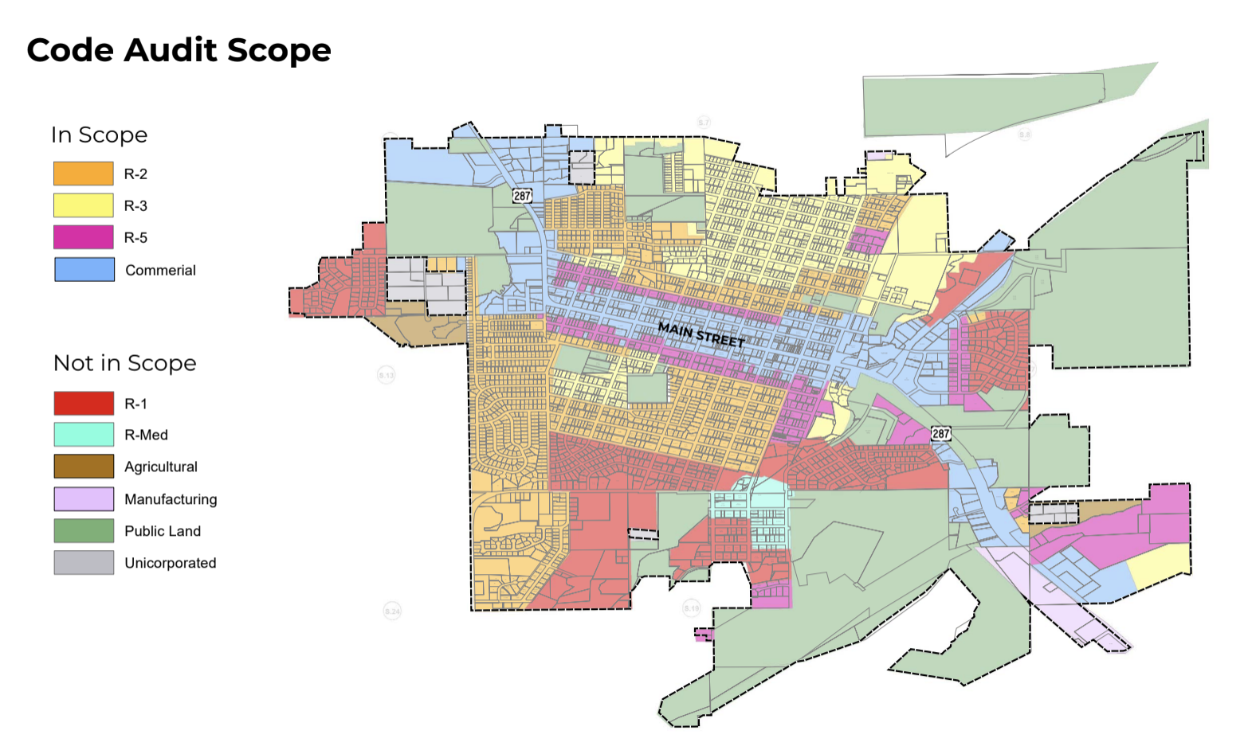
Code Review

Slide 7
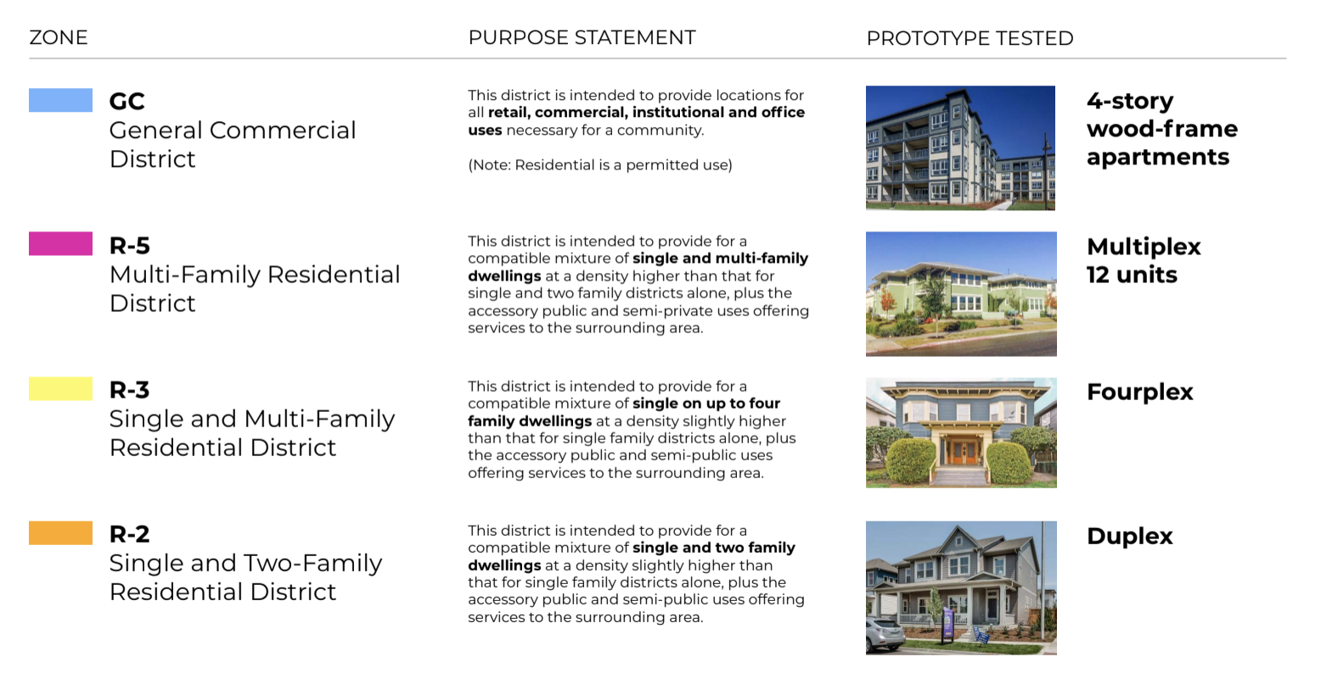
Code Review

Slide 8
Opportunities
Decrease minimum lot sizes
Increase amount of lot coverage
Decrease Off-street parking requirements
Allow secondary dwellings on lots-- ADU Additional Dwelling Units
Decrease Set backs from lot lines
Allow “pocket neighborhoods”
Form-based Standards
  Heights
  Garages

Slide 9
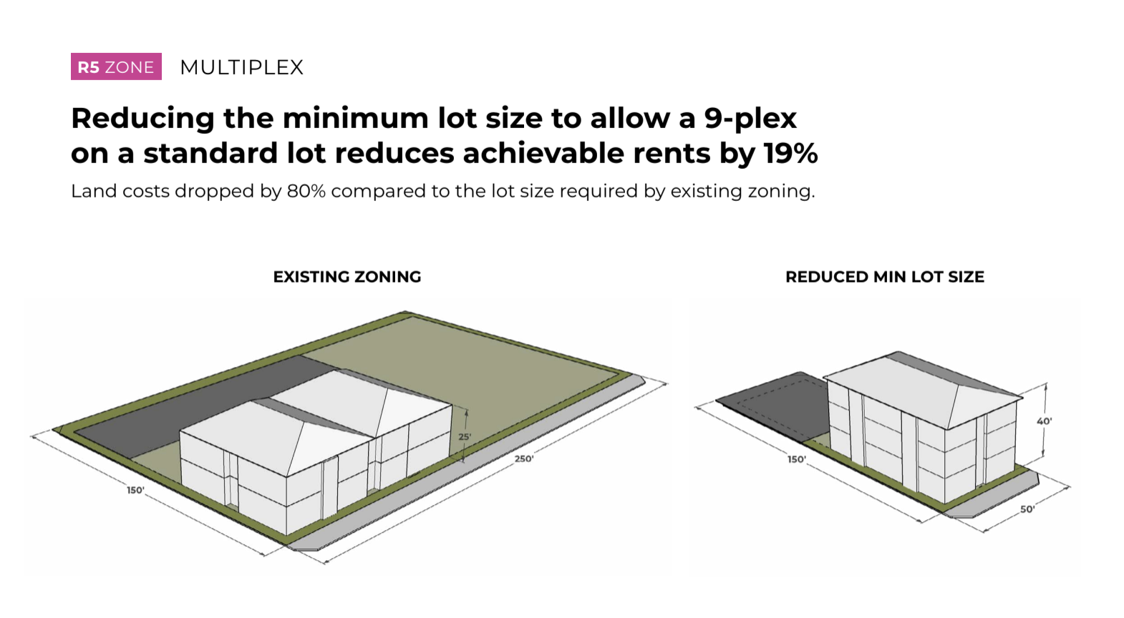
Decrease Minimum Lot Size

Slide 10
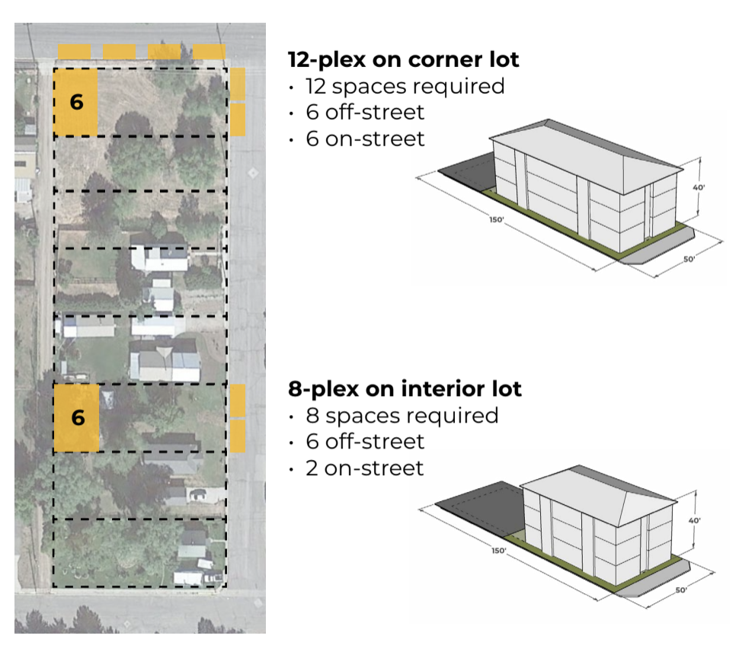
Decrease Off-street parking requirements

Slide 11
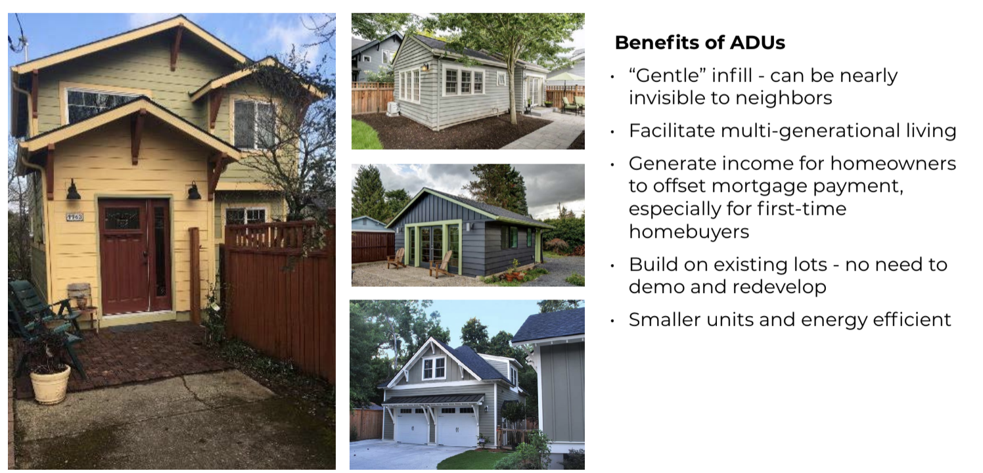
Additional Dwelling Units ADUs

Slide 12
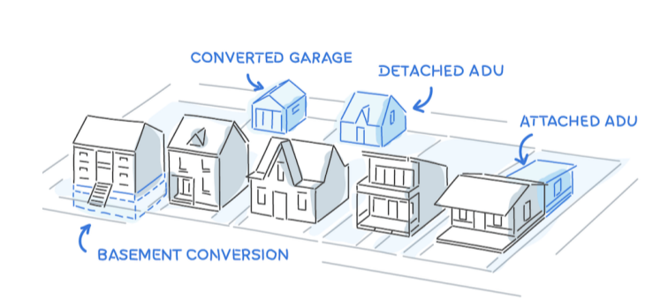
Additional Dwelling Units ADUs

Slide 13
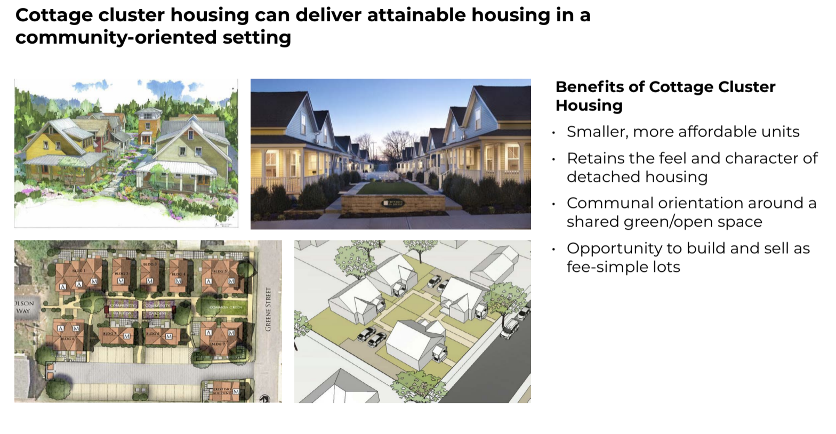
Pocket neighborhoods

Slide 14
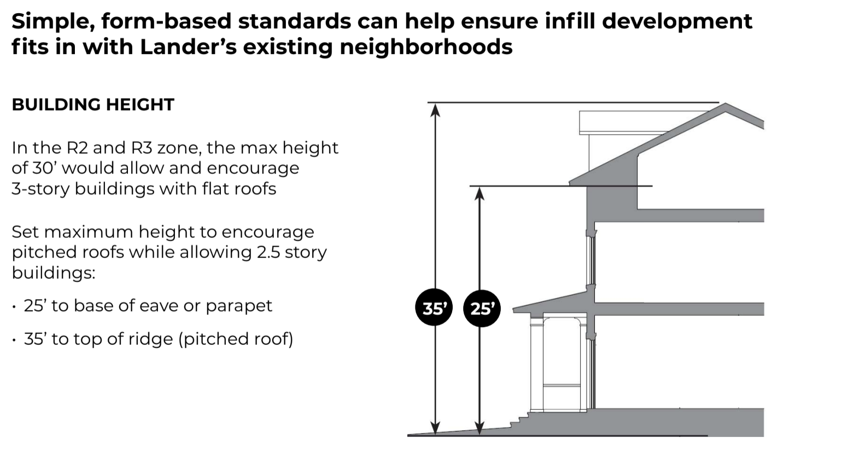
Form-based Standards

Slide 15
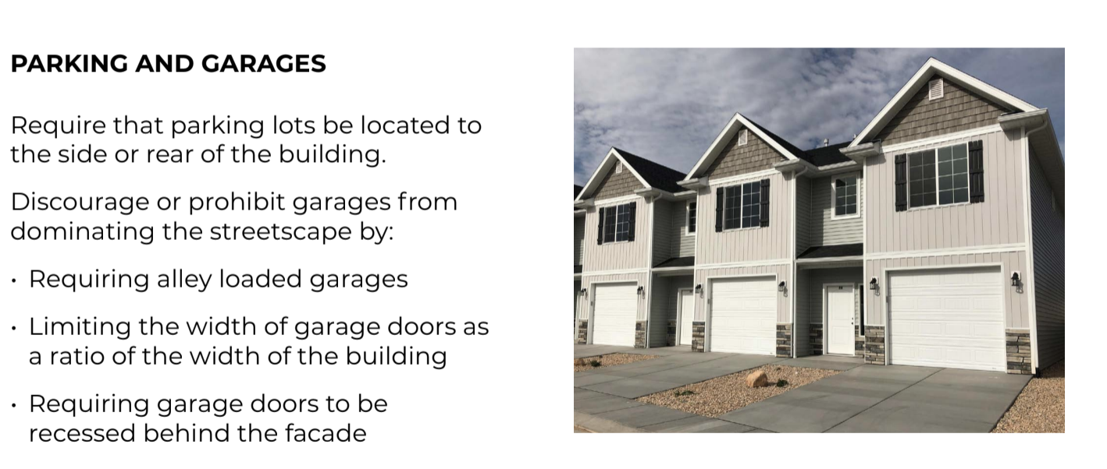
Form-based Standards

Slide 16
Challenges in moving forward
Street frontage is personal property
Change unwelcome
Misinterpretation of code is easy
Disinformation travels rapidly
Confusion between code and aesthetics
Misunderstanding of property taxes
Misunderstanding of property value due to neighbor property

