Slide 1
Think Like a Developer
Mike Scholl, Ayres Associates
Cheyenne, WY
Laramie Main Street Alliance

Slide 2
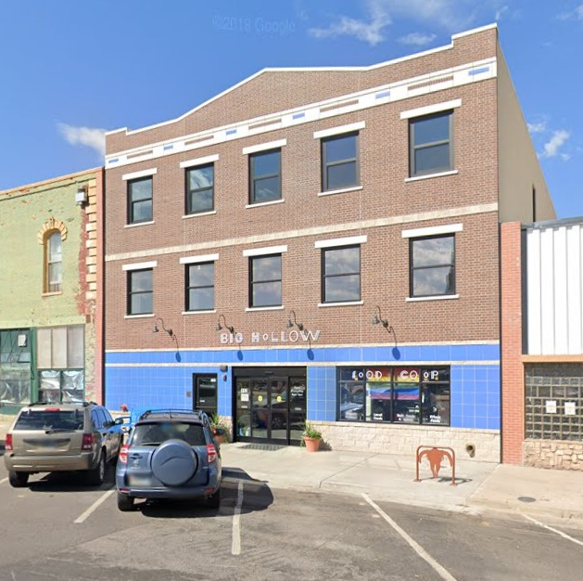
Empress Building
Property was granted to the Alliance due to a fire.
Re-built to include a co-op grocery.
Currently, building out the 3rd floor for three units of residential.

Slide 3
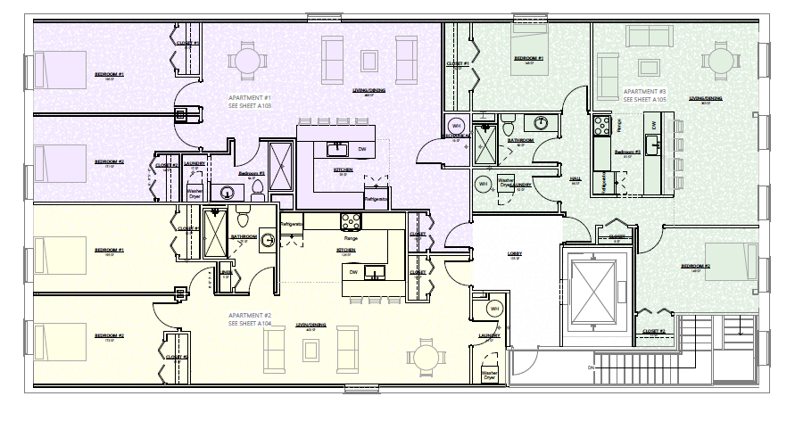
Why we did it and who benefited
Laramie Main Street Alliance is acting as their own developer.

Slide 4

Partners and their roles
Initial construction was funded by a grant from the Wyoming Business Council.
Additional work is being financed by a local bank.
Will add three new units of housing in the downtown district.

Slide 5
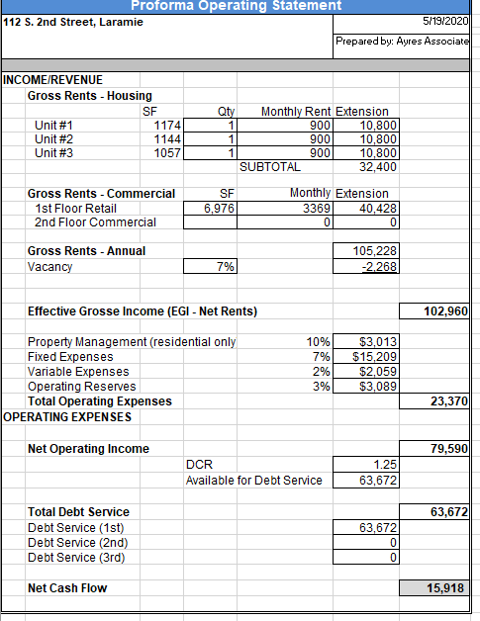
What it cost and how we paid for it
Alliance is acting as their own developer.
Financing the project based on income from the anticipated residential units.
  Roughly $600,000 in construction costs on 3,600 sq/ft.
  Three units of around 1,200 each.
When completed it will generate roughly $15k to $20 year in income plus the building equity.

Slide 6
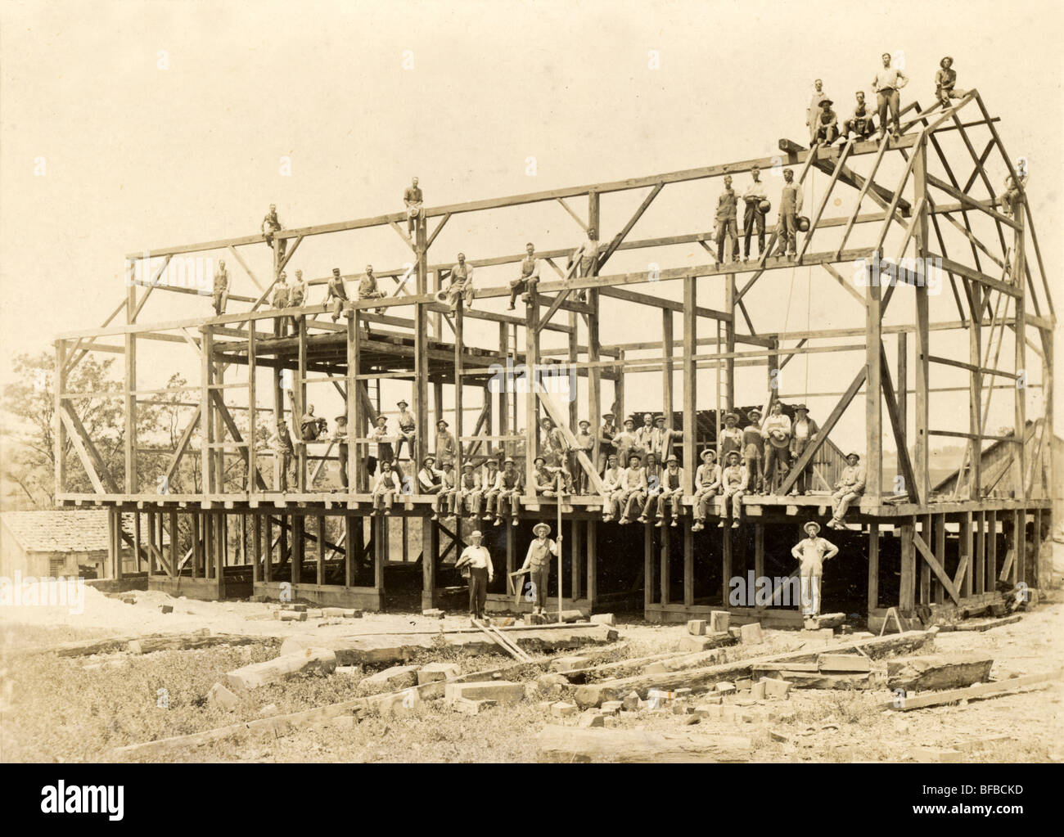
Lessons learned that could help other communities
Take charge of the Real Estate in your community!
Don’t wait, if the developer hasn’t shown up yet, they probably aren’t going to.
Sometimes a “boot strap” approach is required.
If you control the real estate, you control your future.

