Slide 1
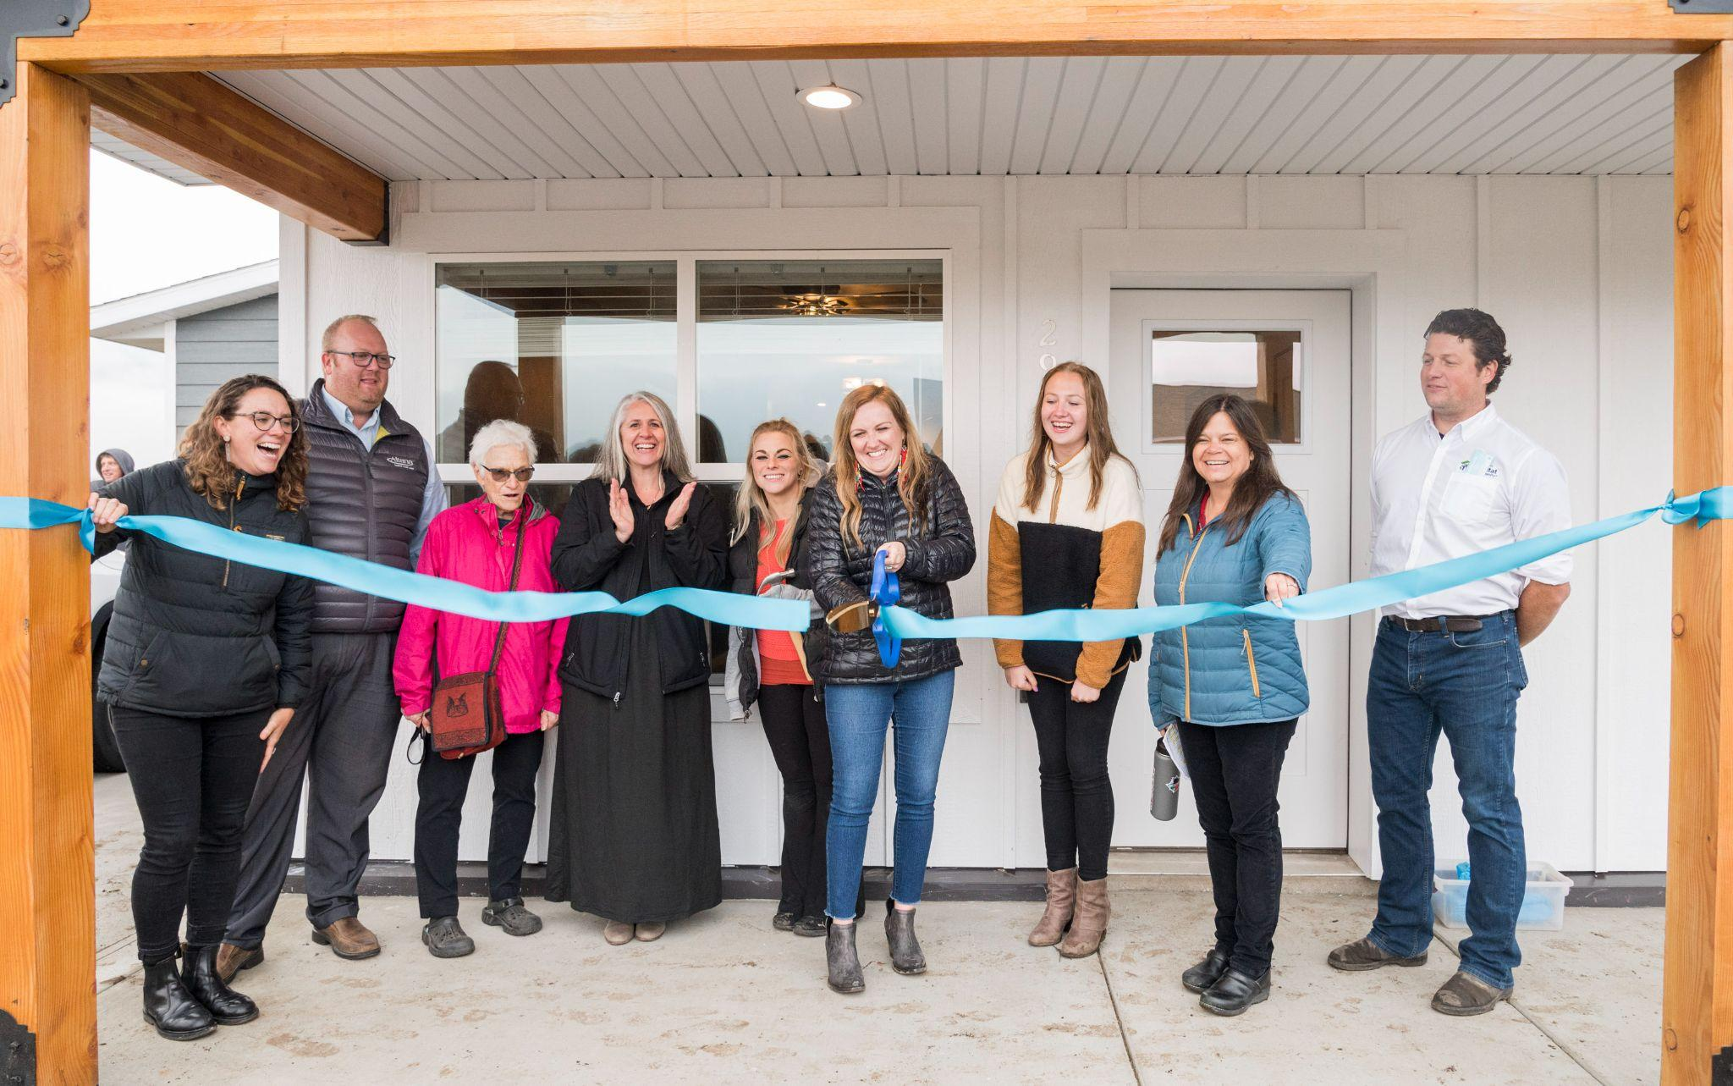
Owner-Built Housing
Robin Adams | Workforce Housing Coordinator
Red Lodge Area Community Foundation
Red Lodge, MT

Slide 2
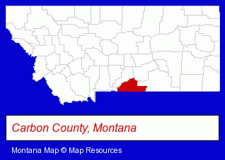
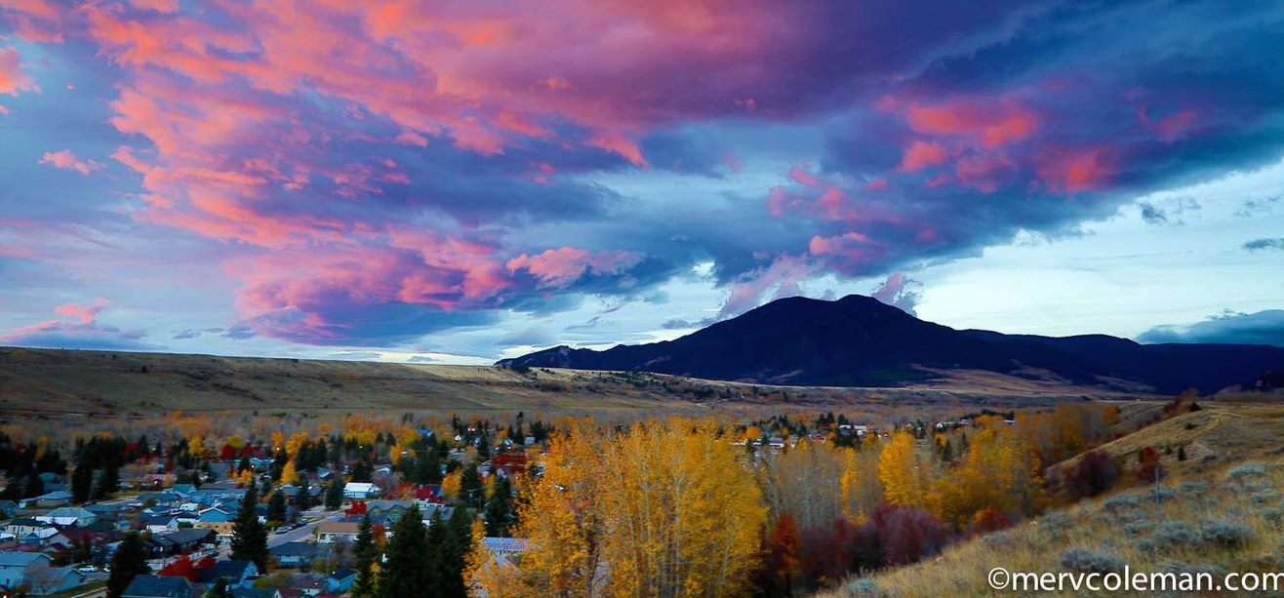

Slide 3
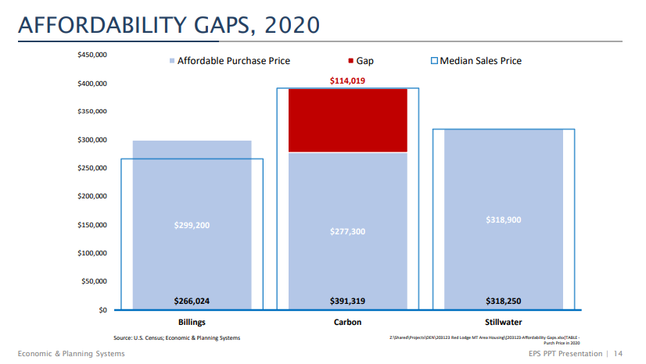

Slide 4
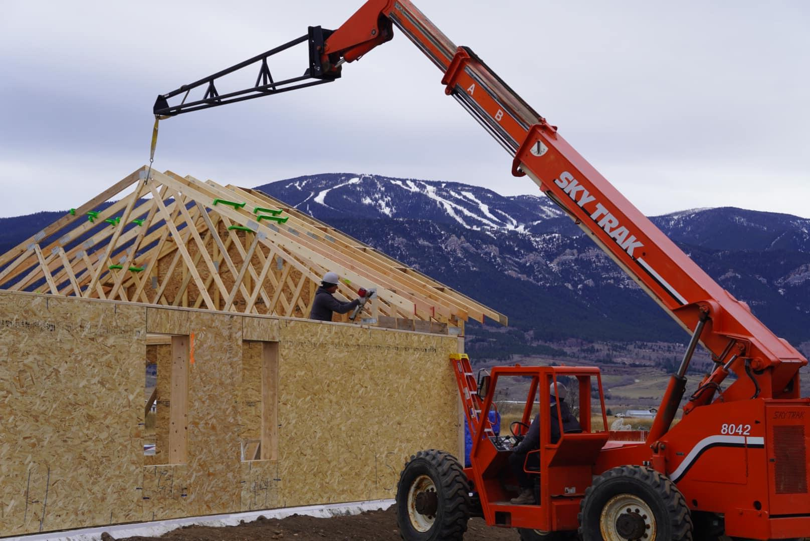
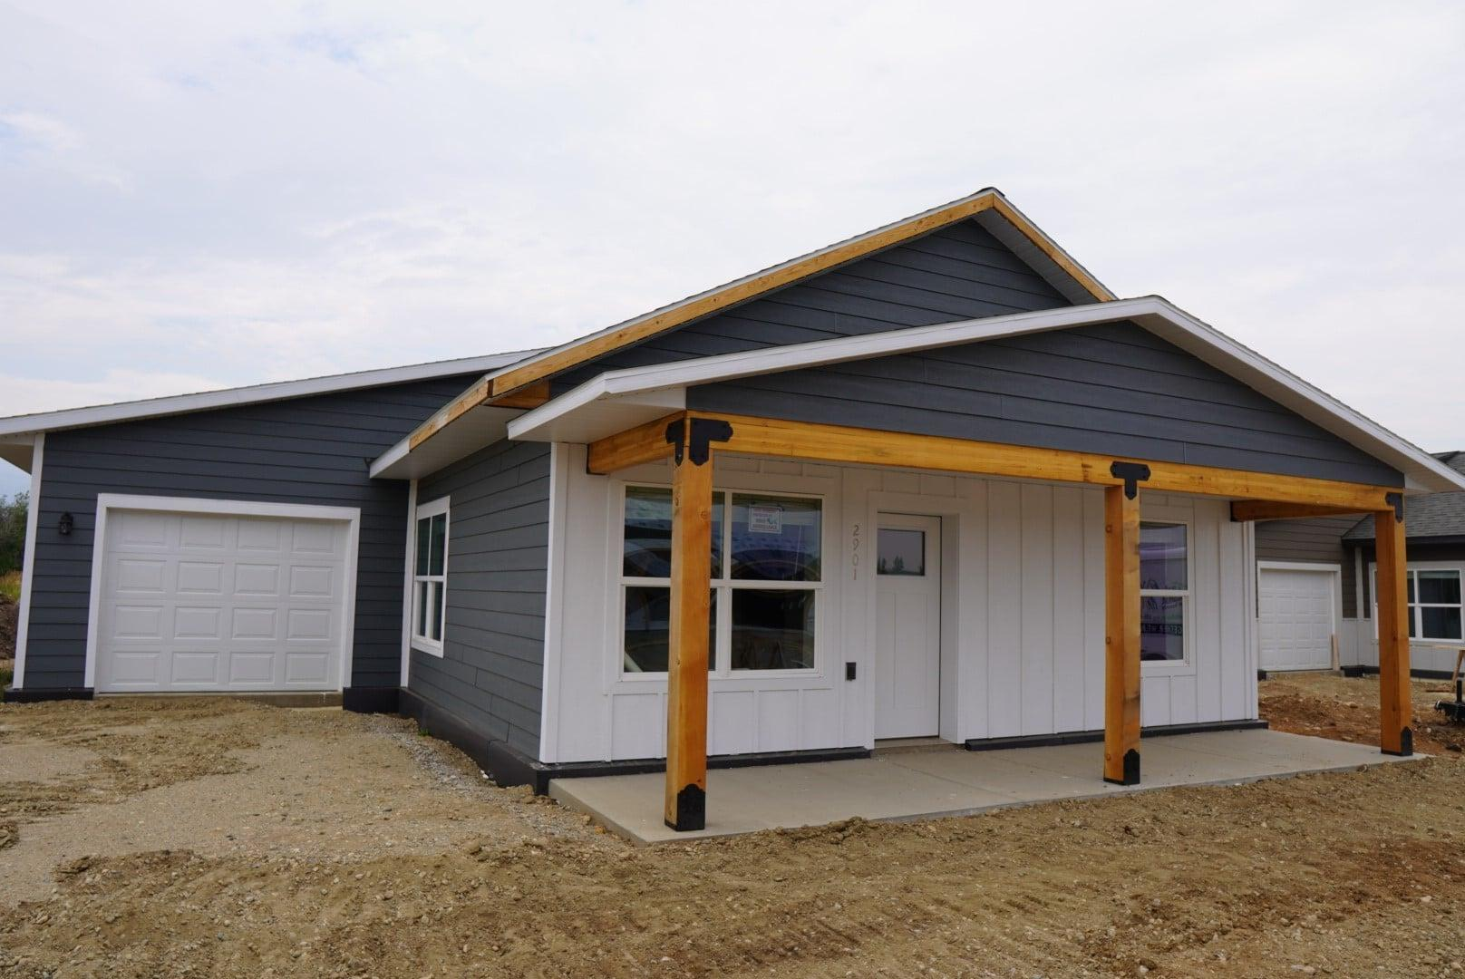
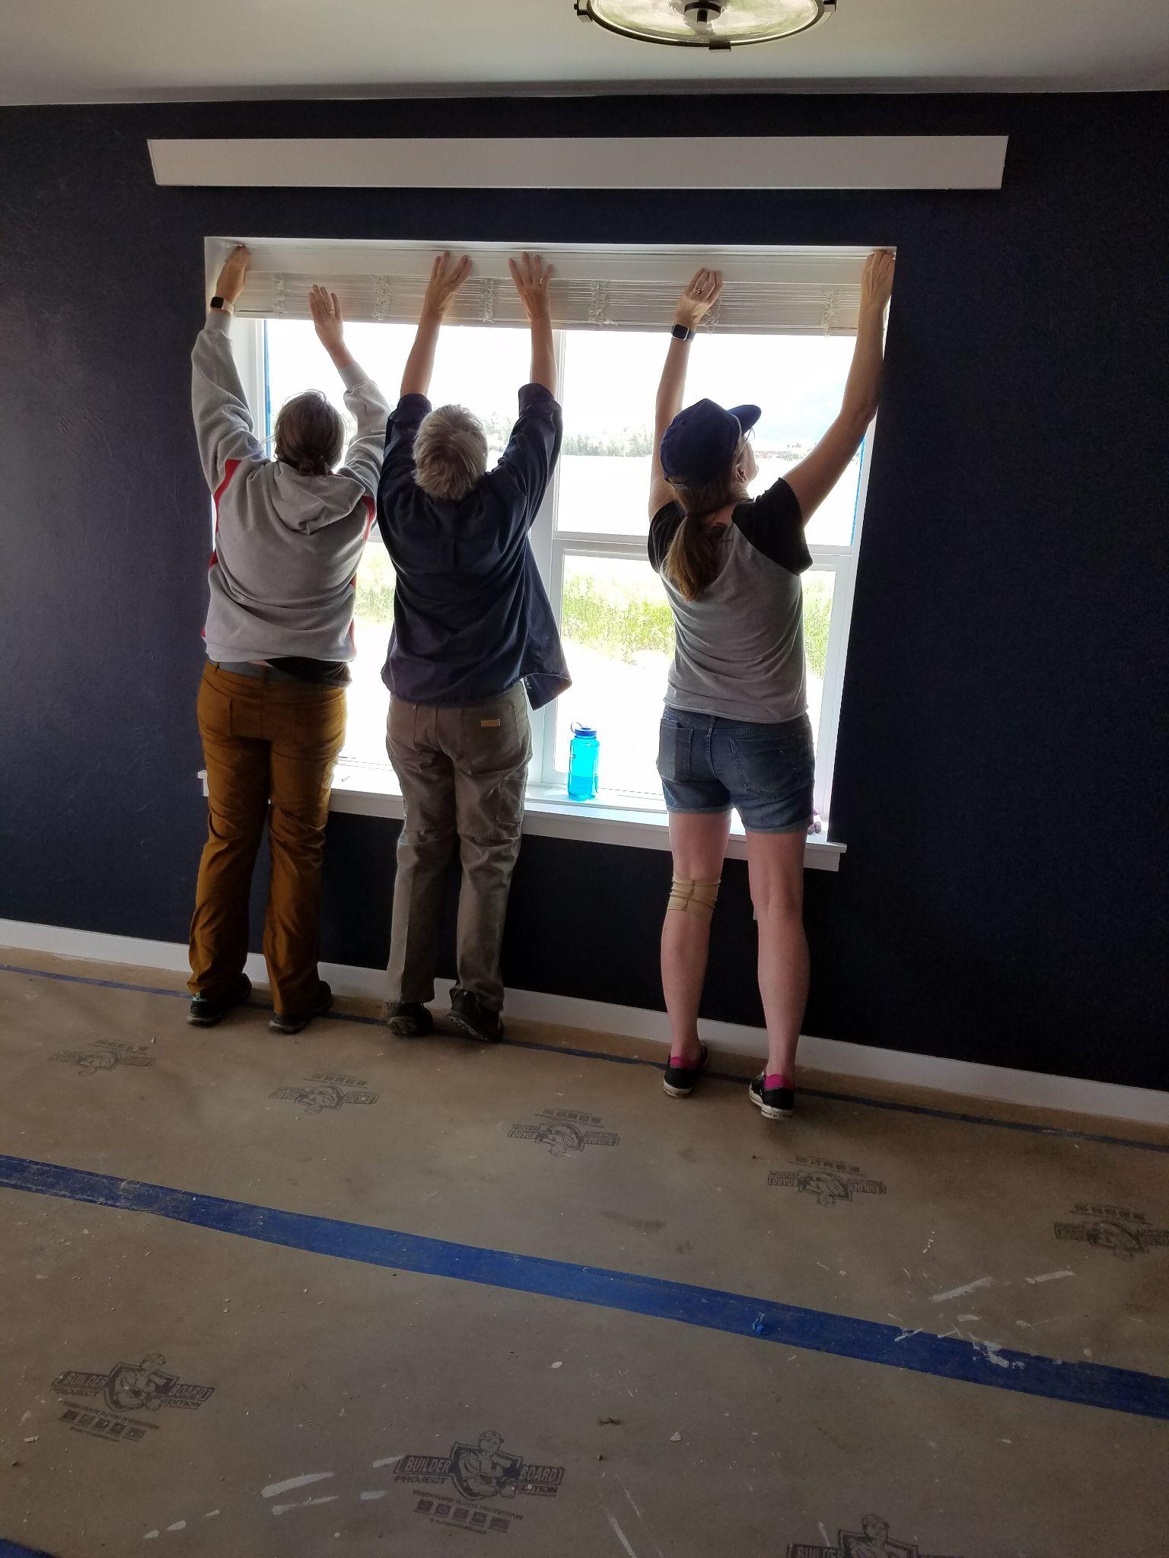
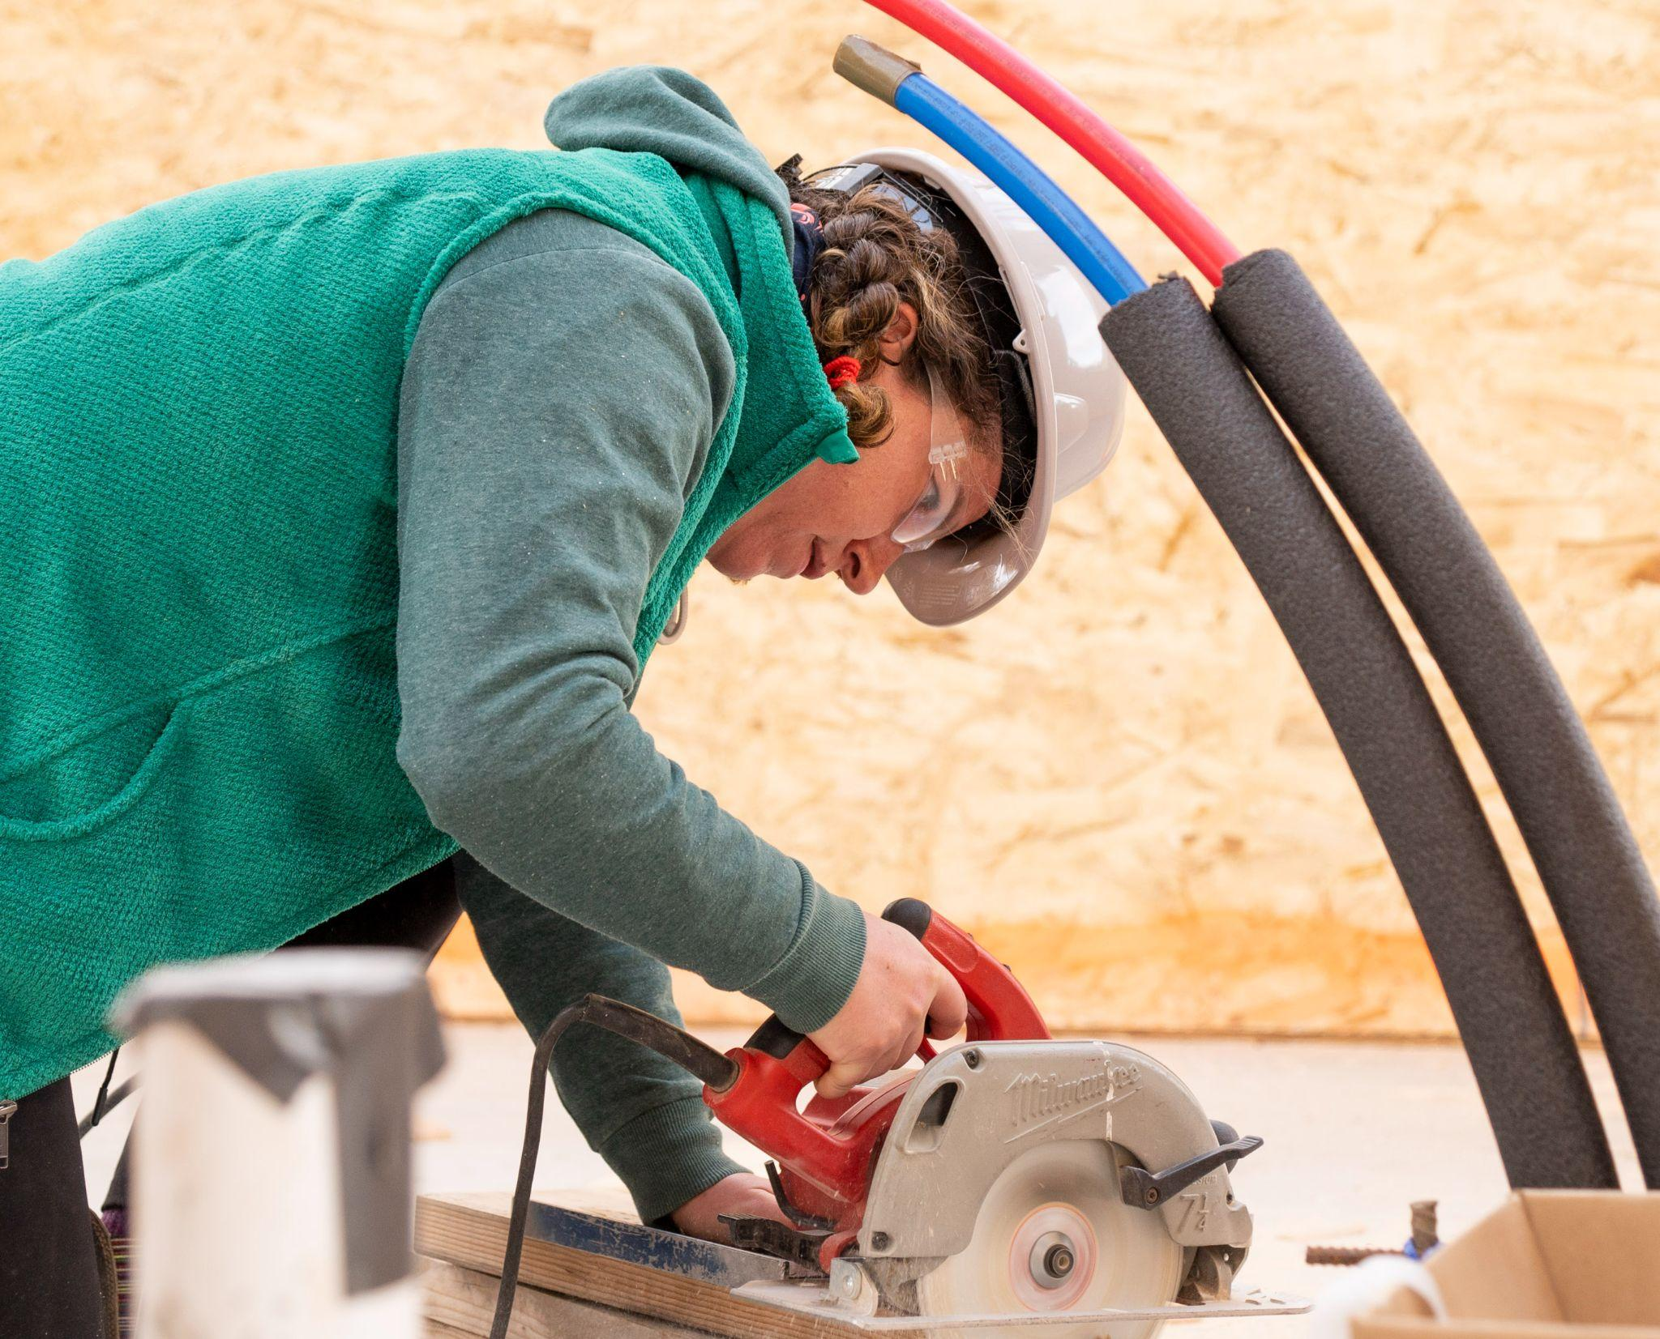
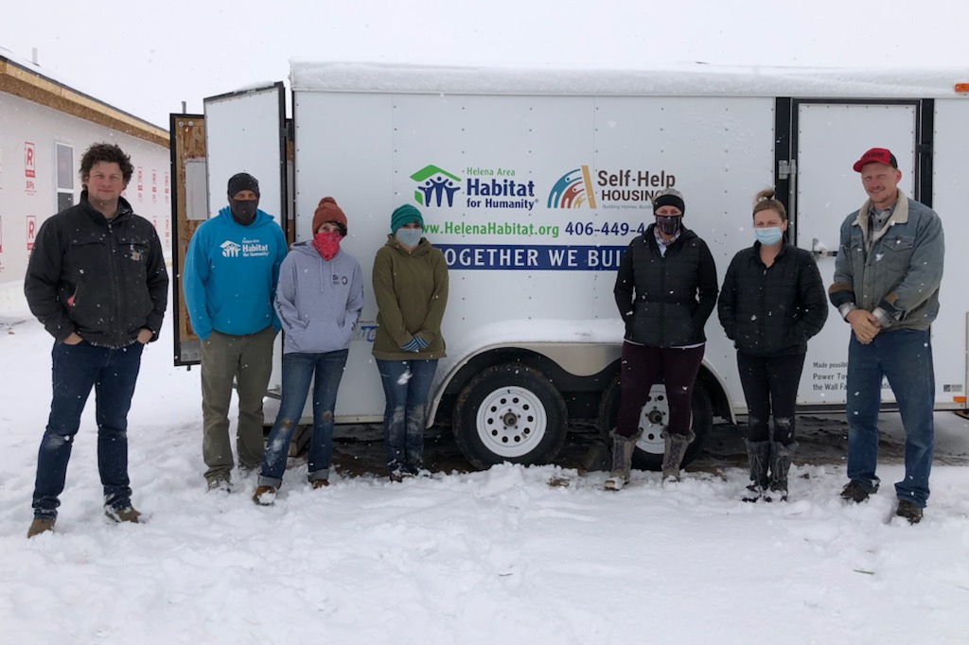

Slide 5
Key Partners

Slide 6
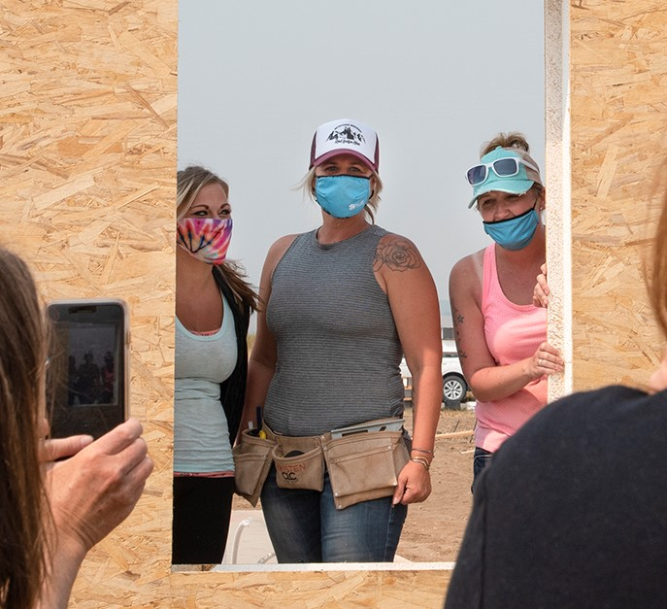
Qualified applicants:
demonstrate need for housing
work or live in Carbon County
are willing to commit to sweat equity requirements
have stable income, minimal debt, and positive credit
fall within 80% AMI limits for Billings Metro Area*
*2021 income limits for Carbon County are up to $64k for a 1-4 person household and $84.5k for a 5-8 person household

Slide 8
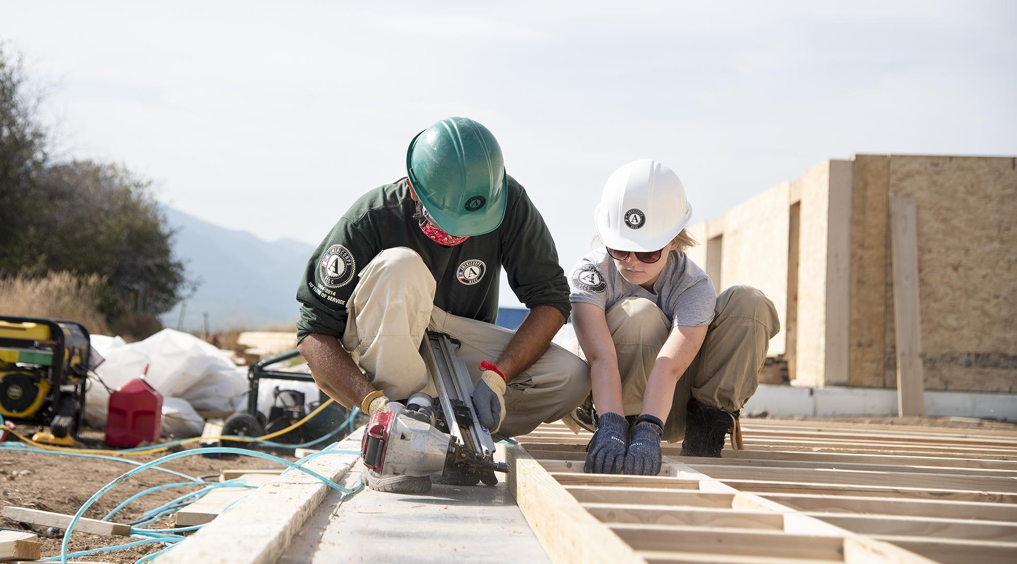
Timeline
RLACF inherits Carbon County Habitat for Humanity’s assets after the affiliate dissolves
A family purchases our first community land trust home in Red Lodge, the “Cooper House”
Owner-Built Housing program launches, construction begins
2016
2019
2021
2015
2018
2020
Conduct a Housing Needs Assessment and Housing Strategic Plan for the Red Lodge area
Owner-Built Housing program development and first-time homebuyer education outreach
3 families move into the homes they built with Helena Area Habitat for Humanity, 3 more owner/builders begin construction

Slide 9
Future Development Plans include:
3 more families moving into the homes they’ve built in 2022
an additional 4 Owner-Built homes starting construction in 2022
4 affordable long-term rental units built in 2023
i.e. by 2023, we will have built 15 total homes for Carbon County locals with our partner organizations

Slide 10
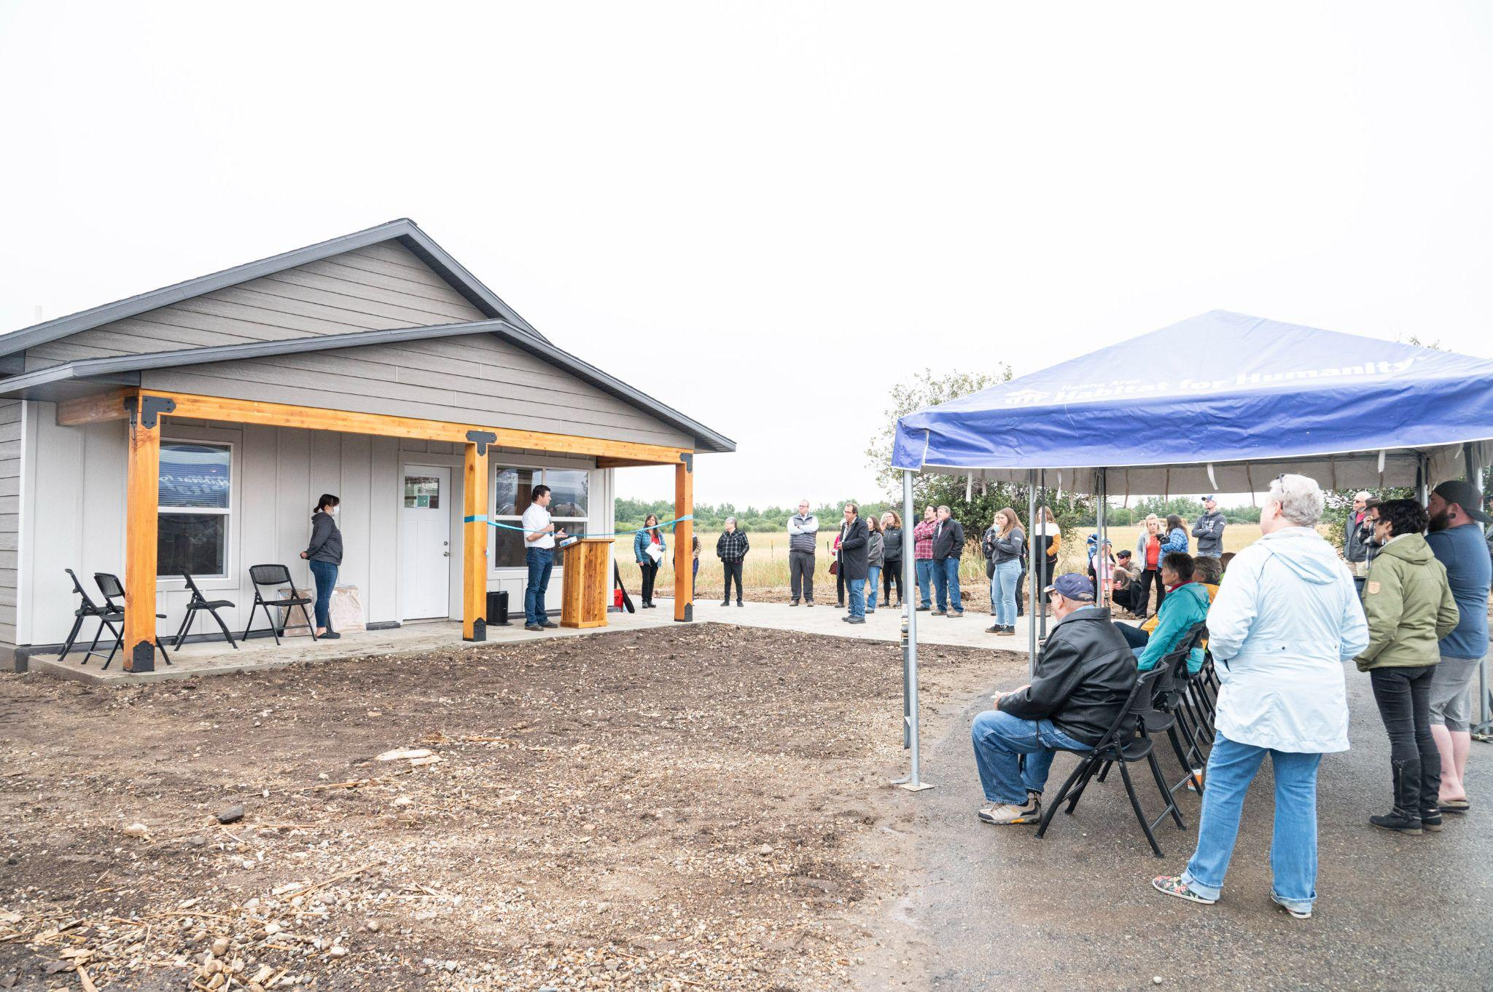
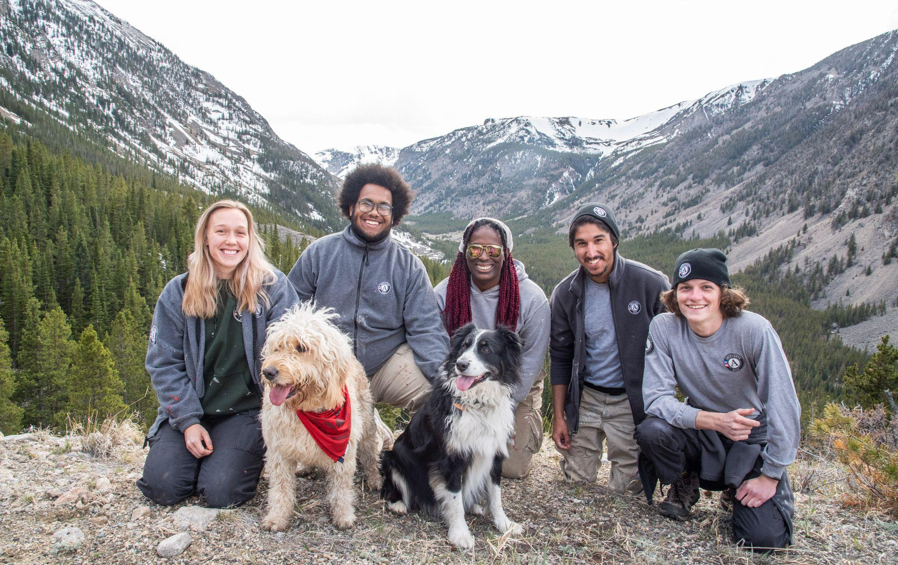
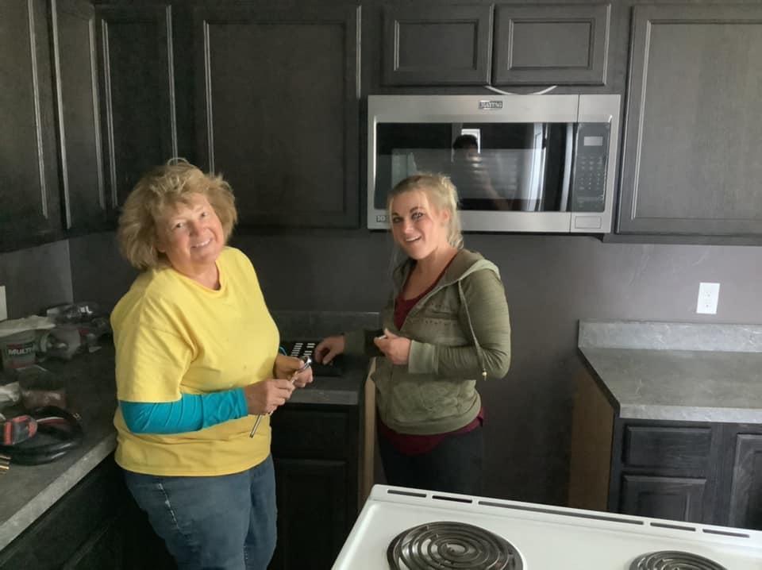
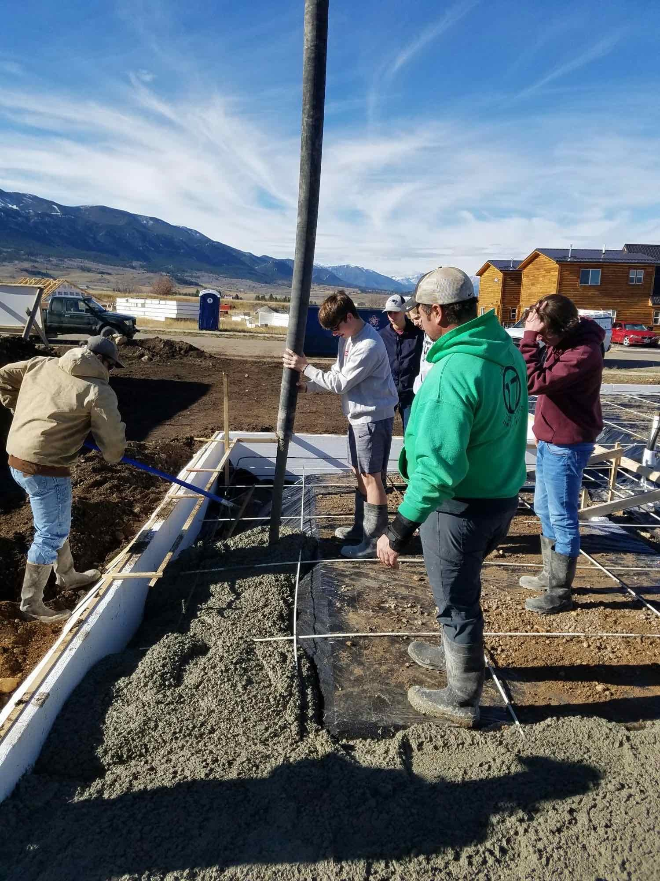
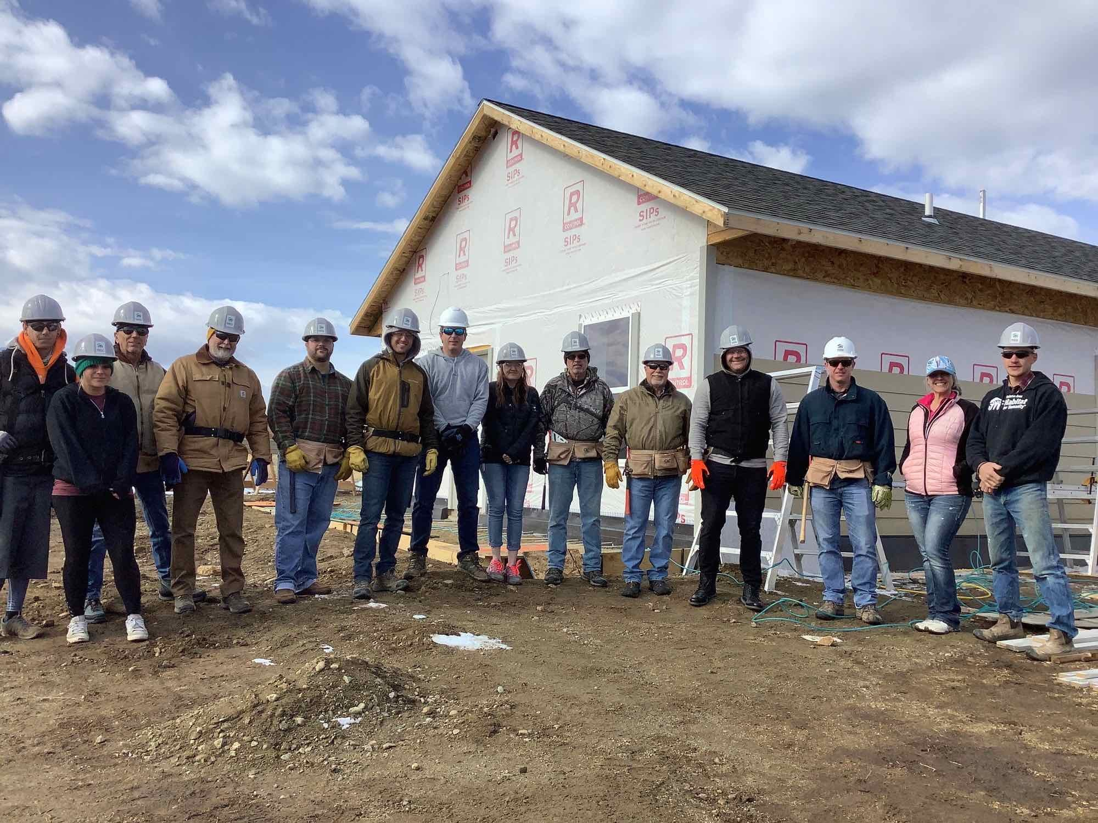
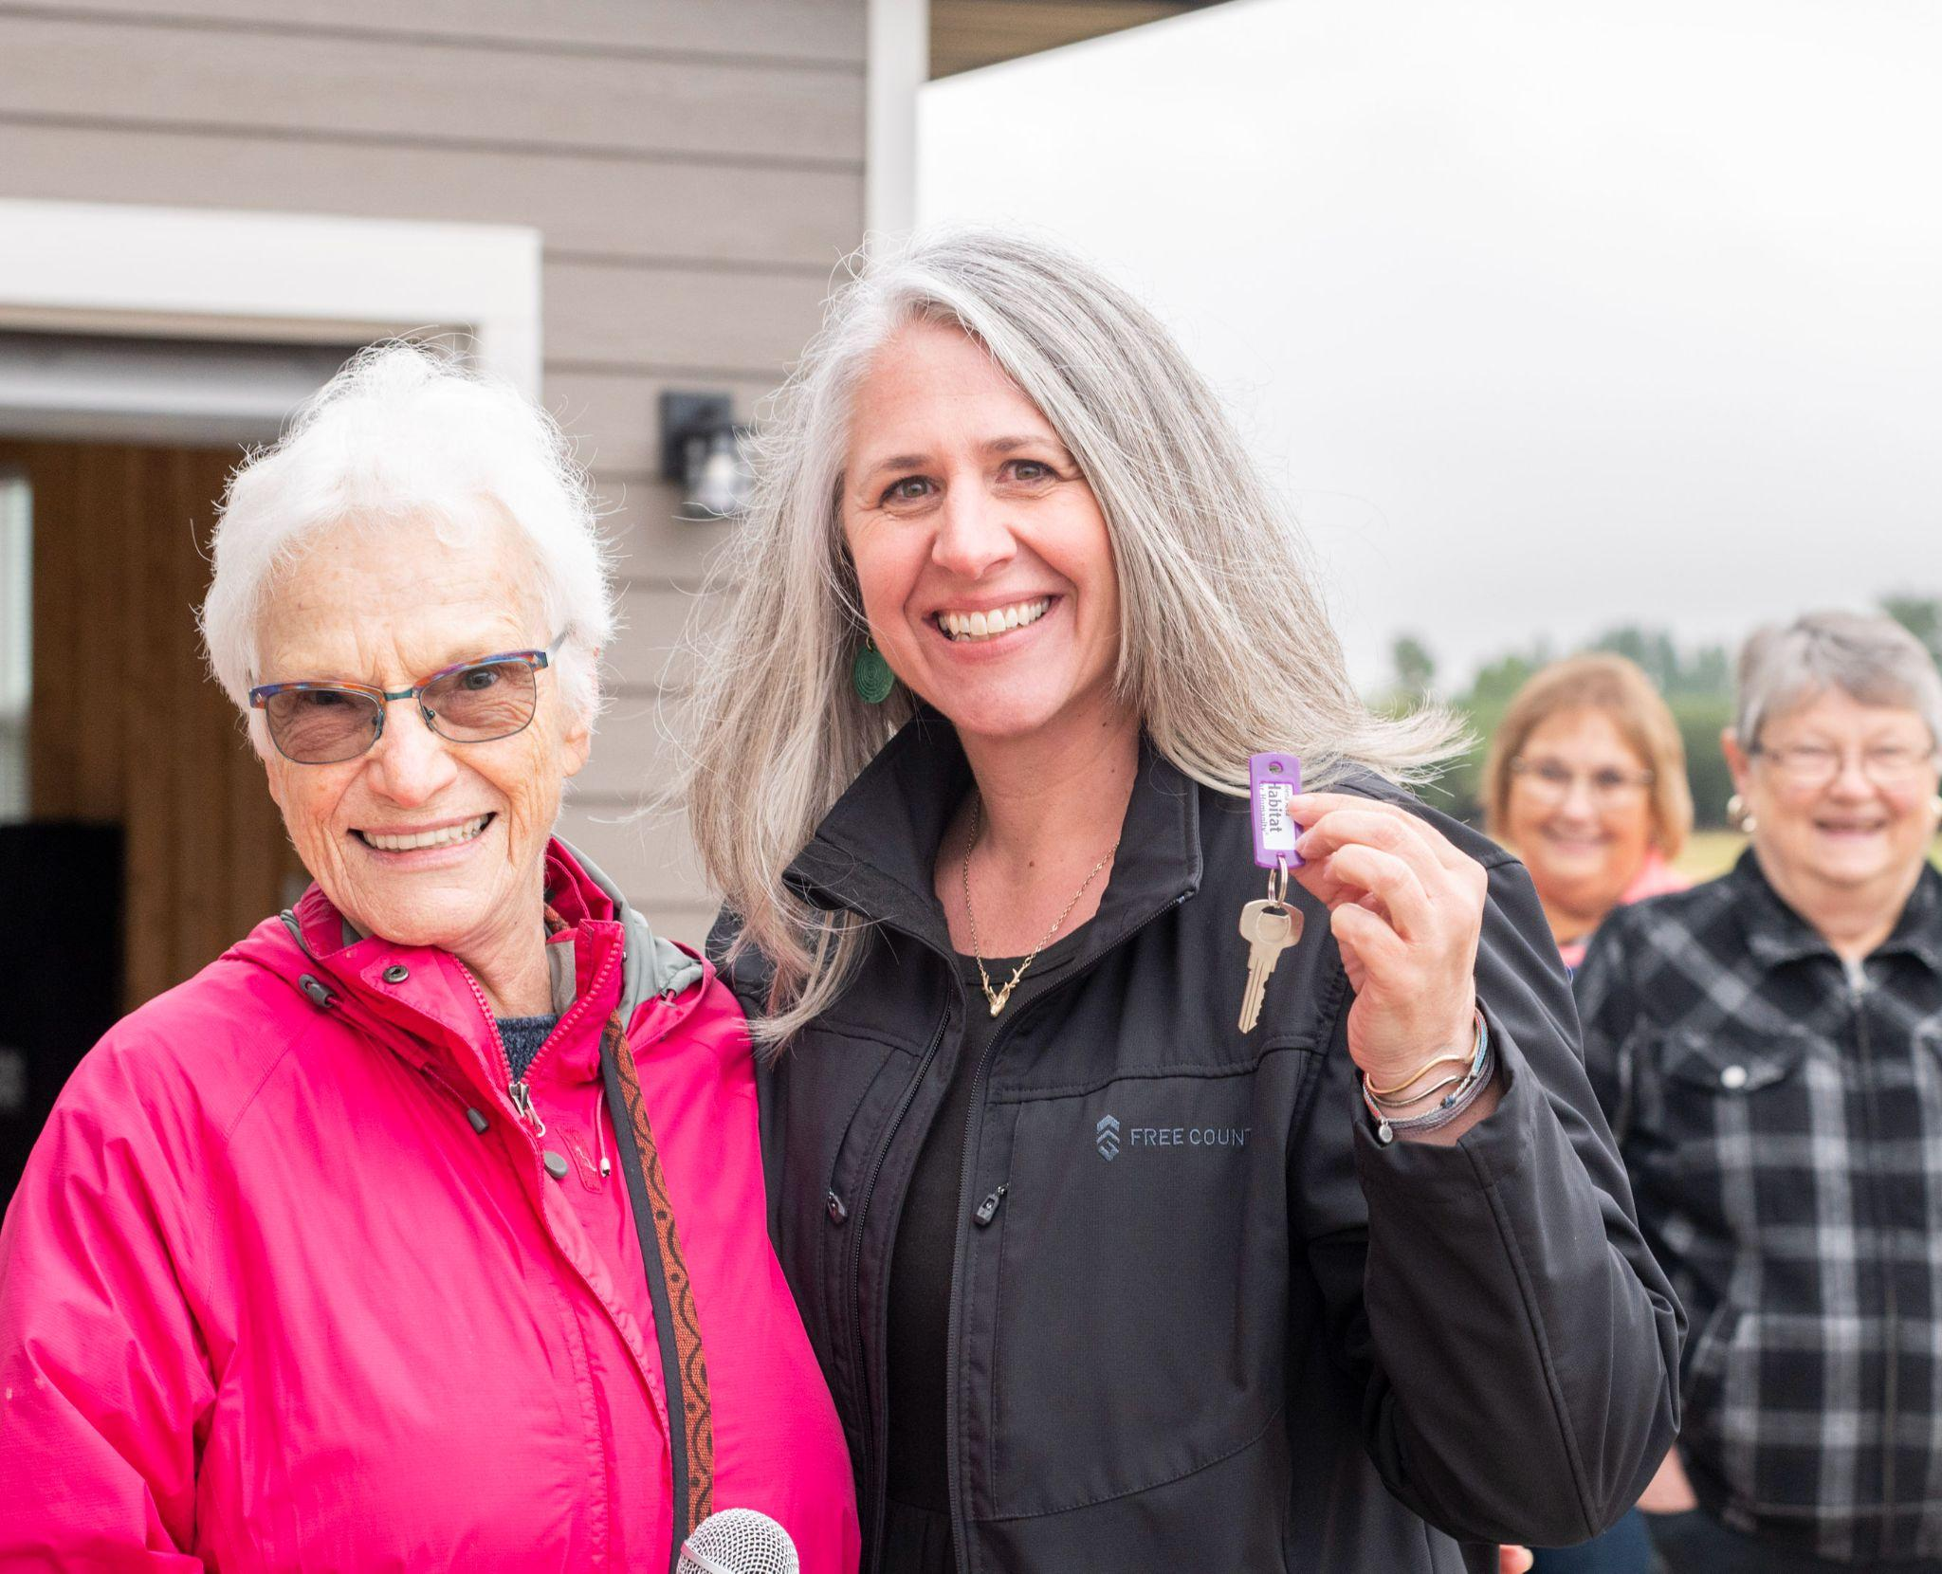
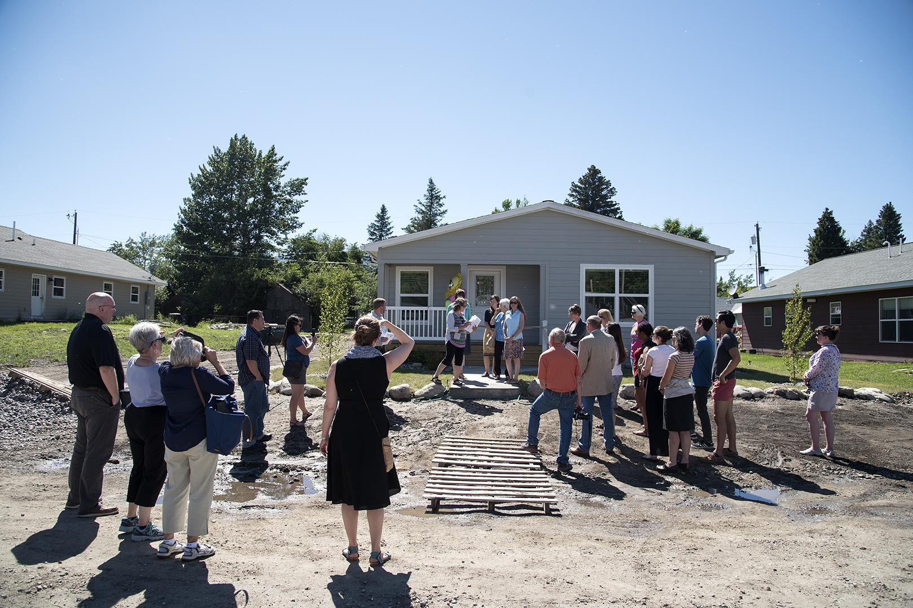
Most important lesson learned:
LEVERAGE PARTNERSHIPS TO GET THINGS DONE

