Slide 1
Local Housing Incentive Program
Michelle Groenevelt, AICP
McCall, ID

Slide 2
Project Overview
McCall Area Comprehensive Plan
City of McCall Housing Strategy
Incentive Program
Land Banking
RFP on City/URA Land
Regulatory incentives/requirements
Annexation
Seasonal Housing
McCall Local Housing Program
McCall Local Housing Action Plan
Support a variety of housing opportunities to allow people to live and work in McCall, and to provide affordable opportunities for low- to middle- income employees, seniors, and persons with special needs.

Slide 3
Why we did it and who benefits
“Local Housing”
moved away from income qualifications
Incentive
Start with an incentive rather than a regulation
Notes:
Local Housing
Incentive

Slide 4
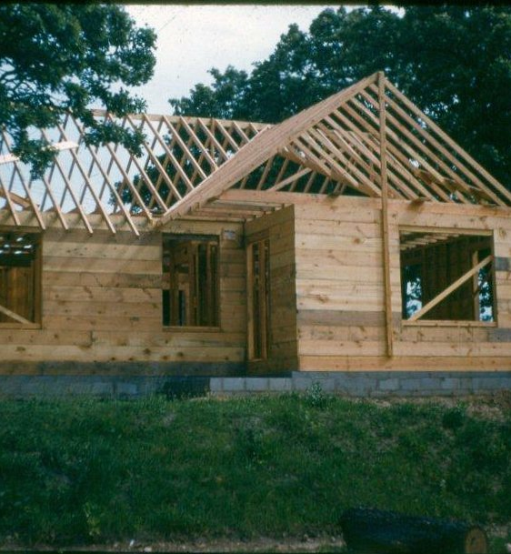
McCall Local Housing Incentive Program
Deed Restrictions
Criteria for Eligibility
Geographic Area
Rental or ownership
Owner/developer sets base rate
Appreciation cap- 3%
Annual or random audits
This Photo by Unknown Author is licensed under CC BY-SA

Slide 5
Partners and their roles
Public/Private Partnership
Developers/Property owners
Contractors
Realtors
Housing Authorities
Housing nonprofits
Local government
Local employers

Slide 6
What it cost and how we paid for it
$10,000 per deed restricted unit- reimbursement
Local Option Tax- annual allocation/application process

Slide 7
Evaluation of Incentive Program
Currently evaluating the Program
What works?
What needs to be changed?
Can we create other incentive programs?
Improve the deed restriction document
Who is administering this program?
How to fully fund the program?
There is no silver bullet

Slide 8
Overall community benefit
Low program cost over time
Privately constructed and managed
Units can be integrated throughout community
Rental or For Sale Units are deed restricted in perpetuity.
Notes:
Pe

Slide 9
Lessons learned that could help other communities
Deed restrictions
What are your goals?
Who manages?
Enforceability?
Funding
Sustainable funding source
Specific to market conditions
Then evaluate program.

